Slide 1

Drug UTILIZATION management
Essential Protection package
Offered by: Cigna Health and Life Insurance Company, Connecticut General Life Insurance Company, or their affiliates.
906098 04/17
Notes:
Misuse/abuse of drugs, price increases for branded drugs, and increased use of specialty drugs requires a stronger, more involved approach to pharmacy benefit management.
Cigna’s drug management program is critical to addressing potentially unnecessary or harmful drug treatments and helping to ensure clients and customers are protected not only from the negative impact of misuse/abuse of drugs but also from rising drug costs. The Essential Protection package drug management package monitors certain prescriptions so that customers can receive the right drug, for the right indication and for the right price.
The next few slides will cover just how drug management helps improve safety for your employees while also controlling plan spend.

Slide 2
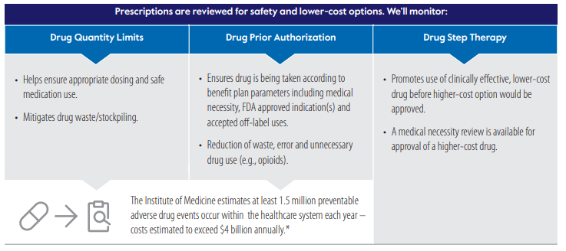
Anyone impacted by this change will receive a letter with explaining the drugs impacted

Slide 3

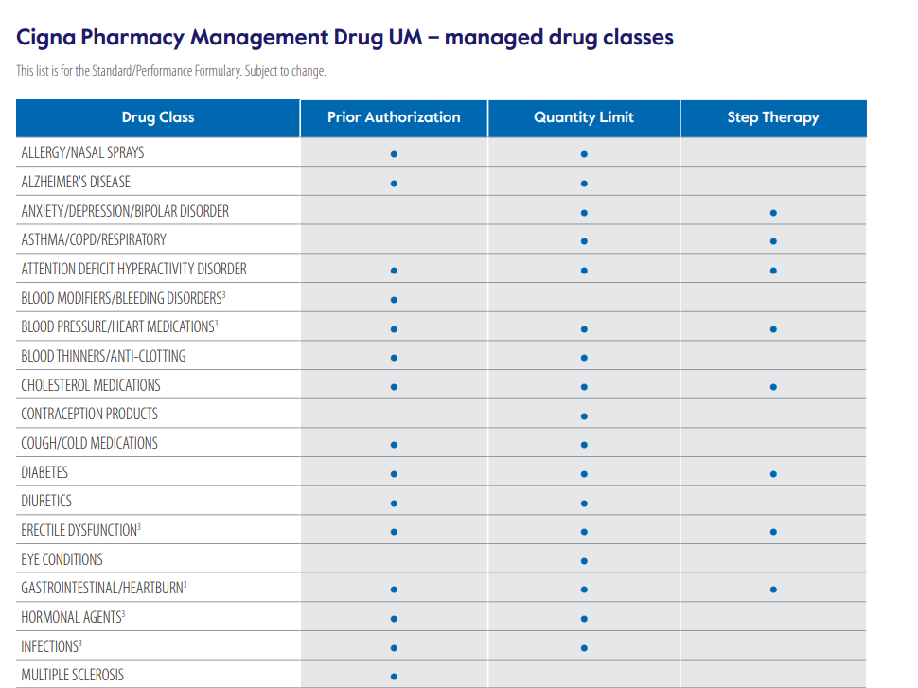

Slide 4

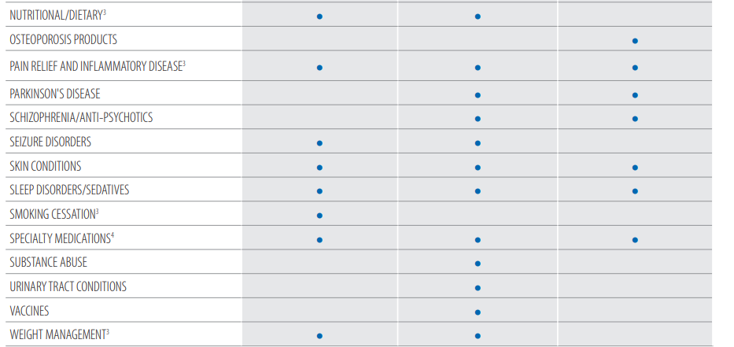

Slide 5
EncircleRx for Cigna Healthcare
Weight Management

Slide 6

EncircleRx for Cigna Healthcare + Omada
Omada® is included with EncircleRx as the lifestyle modification program partner to support customers taking GLP-1 medications for weight loss*
Onboarding before starting medication after prior authorization is approved
Enrollment requirement for GLP-1 coverage
Educational customer outreach
Supporting weight loss while taking medication
Engagement requirement for GLP-1 refill coverage
Lifestyle education related to nutrition and behavioral health
Care team and community support
Maintaining healthy weight long-term
Maintenance-focused lifestyle education
Continued engagement with care team and support community
*Omada will also be available for those not using GLP-1 medications
© 2024 Cigna Healthcare.
6

Slide 7



Here’s an example of how EncircleRx works
1
2
3
4
All clients (new and existing) can communicate availability of EncircleRx to covered members.
Doctor prescribing a GLP-1 medication is prompted to submit a prior authorization (PA).
Prior to getting the drug, Omada reaches out to customer to enroll in our Omada lifestyle program. Once enrolled, the customer receives a scale and learns more about the program and requirements.*
Customer meets new criteria for the program (Omada enrollment, BMI) and PA is approved.
7
6
5
Customer must lose 5% of their body weight by their first medication PA renewal. If goal is achieved, PA is approved. As the customer continues engagement with Omada lifestyle program, refills of their GLP-1 are available at regular intervals.
Customer engages in the Omada lifestyle program with weigh-ins 4x per month and engagement with the Omada app 4x per month with activities like recorded meals, engaging with community resources, completing a lesson, or setting/achieving a goal
Once enrolled in Omada lifestyle program and the PA is approved, the first prescription is received and customer starts therapy.
      Mary, who is pre-diabetic, was notified about a new benefit through her employer – EncircleRx – that can help her get access to GLP-1 weight loss medications and lifestyle programs to help manage her obesity and related conditions.
8
With the tools to succeed in hand, the customer can discontinue the medication at any time as directed by their provider and prescriber.
*Note: if the customer is new to taking a GLP-1 for weight loss and not enrolled in the lifestyle modification program, Omada will reach out after the rejection at the pharmacy – this rejection is what prompts the enrollment outreach. Example/picture is for illustrative purposes only. Customer results will vary.
GLP-1s have extra coverage requirements.
If you choose to use a GLP-1 to help manage your weight, you'll need approval from Cigna Healthcare before your medication can be covered.
To be approved, you must:
1. Currently have, or had at the time you started using a GLP-1, a body mass index (BMI) of 32 or higher (or 27 or higher and have two weight-related health issues) and
2. Have tried following a lower-calorie diet and/or participated in a lifestyle change program for at least 3 months and
3. Join and participate in Omada’s online lifestyle change program, which is available at no extra cost to you.
7

