Slide 1
On-Highway legacy engines
2017 Million Miler Club Strategy Refresh

Slide 2
Why promote the Million Miler club?
Loyal Cat Truck Engine owners are now achieving 1, 2, 3 and even 4 million miles!
The Million Miler program is a great way to:
Reach out to customers who you’ve lost touch with. This is a great way to reconnect and update your records for future business needs.
Reach out to customers who are new to your territory. This is a great reason for them to visit your dealership to meet.
Reward & thank customers you currently partner with.

Slide 3
Million miler Program overview
Dealer Service Strategy:
Customer has engine in for service, Dealer tracks mileage and enters customer into the program
Or
Dealer service records indicate nearing 1M / 2M / 3M / 4M miles. Dealer reaches out to these customers to make contact and offer the program.
Caterpillar Digital Strategy:
Through data analytics, target customers who are presumed to have 1M / 2M / 3M / 4M miles via RigDig data
Customer is instructed to contact their Authorized Cat Dealer and provide their mileage to be entered into the program.

Slide 4
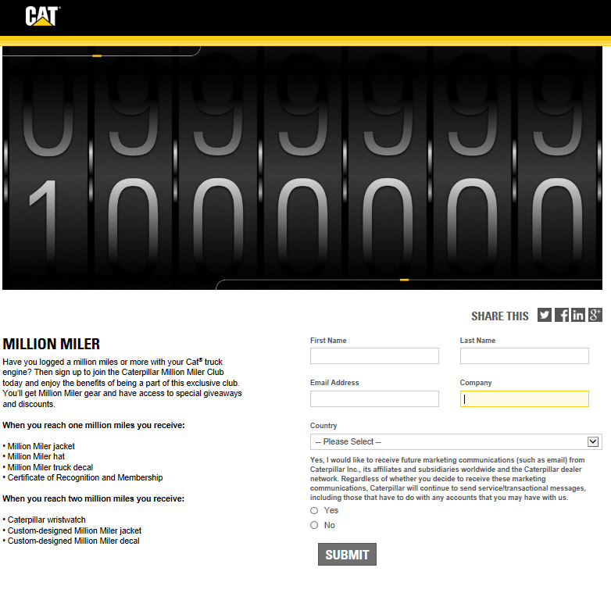
Caterpillar Digital strategy process
Customer Visits cattruckengines.com
Click on “Join Our Million Miler Club”
Provide Name/Email/Company
Receive a Form via e-mail
Fill out Form
Take the Form to an Authorized Cat Dealer
Dealer verifies and follows the existing Million Miler process
Visit truck.cat.com
Select “Products” > “Million Miler Club”
Fill out form using the information provided and any additional fields

Slide 5
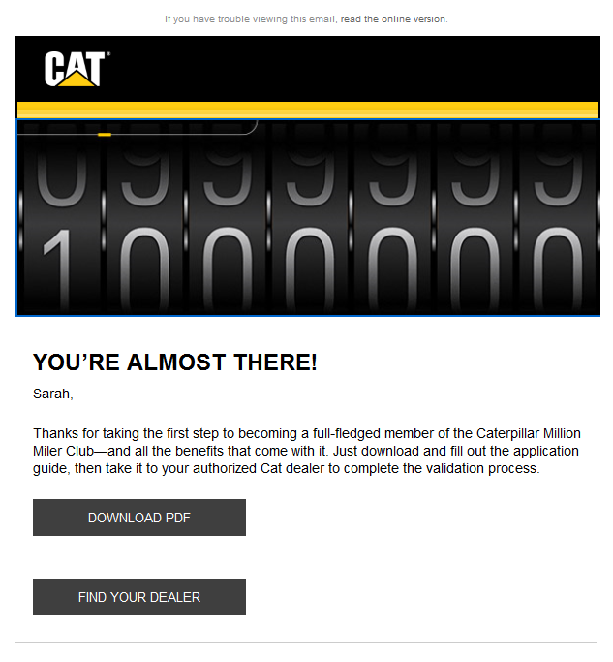
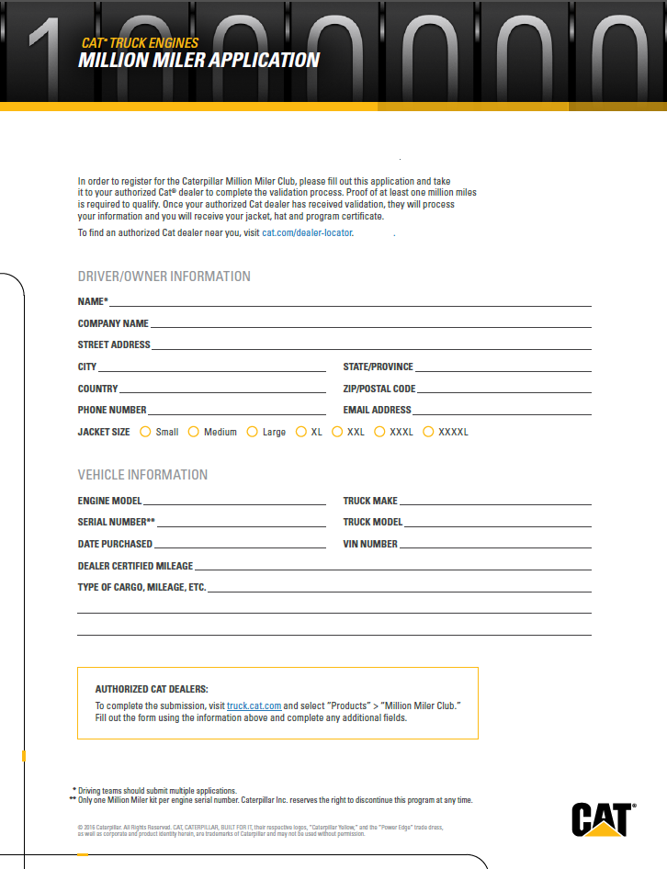
Customer e-mail & form
Customer E-mail
Customer Form to Provide to Dealer

Slide 6
Caterpillar & dealer promotion Materials
Current Million Miler (Banner Ads & Images)
Aspiring Million Miler (Banner Ads & Images)

Slide 7
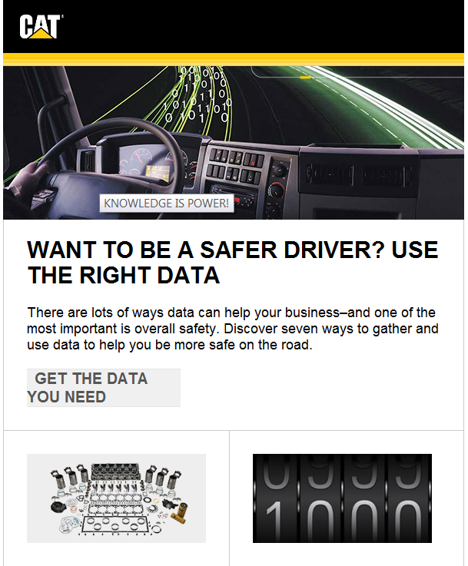
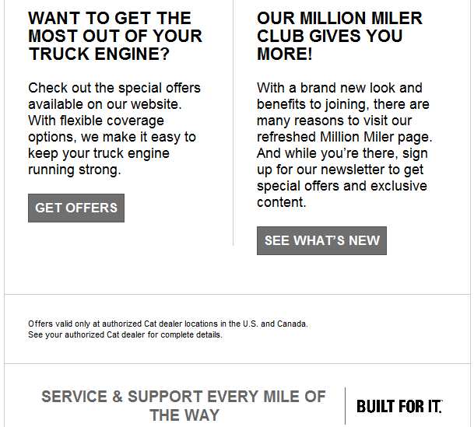
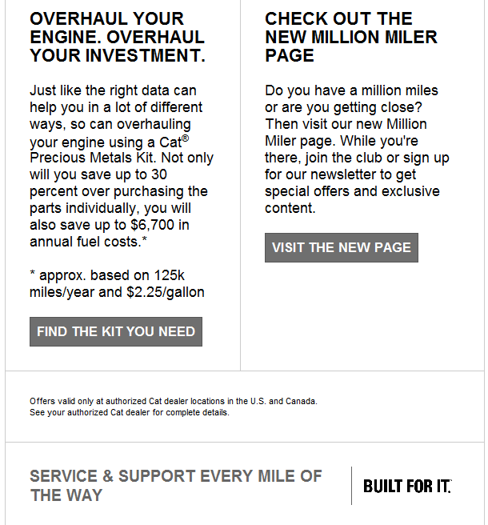
Email samples

Slide 8
Caterpillar & dealer promotion
Next Steps Dealer
Promote the Million Miler Program in your Territory
Target Customers in the Service Shop
Promote the program on Dealer website & Shops
Send E-mail Blasts
Communicate the Million Miler Program to TEPS Dealers
Next Steps Caterpillar
Promote the Million Miler Program via Monthly Newsletter (RigDig Customers with e-mails)
Promote the Million Miler Program via RigDig Targeting Ads (RigDig Customers without e-mails)

Slide 9
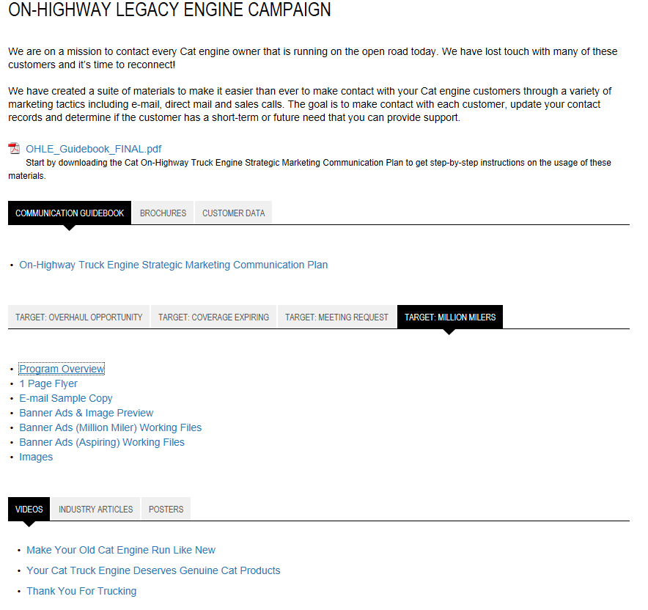
Resources
Promotional Materials
https://dealer.cat.com/en/bt/marketing/depository/campaign/legacy-on-highway-engine-campaign.html
Application Form:
https://truck.cat.com/en/products/million-miler-club.html

