Slide 1
Meet the local parts team

Slide 2
Milton CAT Parts
“Parts is just parts…”
15 different Milton CAT parts locations
$70 million parts inventory
125,000 inbound phone calls per year
90,000 ecommerce orders on parts.cat.com
1,300,000 miles driven to fulfill orders
More than 50,000 customers supported

Slide 3
Parts.cat.com
TEPS dealers are Milton CAT’s heaviest users of parts.cat.com, and we so appreciate that
CAT is committed to enhancing the site, with continuous updates making parts ordering quicker and easier
Just a reminder on the site’s benefits:
Real time price and availability
24/7 parts ordering
Order updates when parts are shipped / ready for pickup
Can have as many users as you would like
Access to order history for the last two years

Slide 4
Parts.cat.com
“Contact dealer”
How frustrating!!
Here are the possible reasons why a part may tell you to contact the dealer
Part is overseas and there may be associated freight when ordered
Part has been replaced by individual parts or updated to a new number
Part is on a freeze and requires a serial number to be ordered
Part is discontinued without a CAT replacement, so we can work with our Allied parts team
Please do give us a call or send an email when you see this message, so we can best serve you and your customer

Slide 5
Parts.cat.com
“Failed product information”
This usually means the part has been replaced
When you see this, go into the NPR to find update
“i” Icon in the far-right column of SIS 2.0
This seal kit, part number 185-6588, updates to part number 246-5914

Slide 6
Stock vs Emergency Ordering
Why is stock ordering important for the TEPS dealer?
Additional 5% savings on all parts
Absolutely no freight charges
Better planning leads to a better chance of having all parts needed at the time the job begins
Why is stock ordering important for Milton CAT?
Emergency orders create fees incurred from CAT for needing items next day
Stock orders allow CAT’s global supply chain to fulfill true unit down orders more quickly
Stock orders allow CAT to fulfill the orders in package quantities, reducing Milton CAT labor and increasing accuracy

Slide 7
Stock vs Emergency Ordering
In-depth look
March 2024 through March 2025
31,000 orders places over the past 12 months
97% of those orders are placed as emergency orders.
2023: $1.1M+ spent by not placing stock orders
2024: $904K+ spent by not placing stock orders

Slide 8
Cores
Entitlement:
Attrition
You have 12 months from date of invoice to return your cores to any Milton CAT location.
Recently we have had TEPS dealers loose in excess of $10K in core entitlement on just one order. CAT is becoming more and more reluctant to make exceptions on your behalf so please be virulent in working to ensure you don’t lose entitlement.
Tracking
Cores can be tracked on Parts.CAT.com, reach out to your TEPS rep or local parts manager if you need help finding this on PCC.

Slide 9
PCC Core Tracking Page

Slide 10
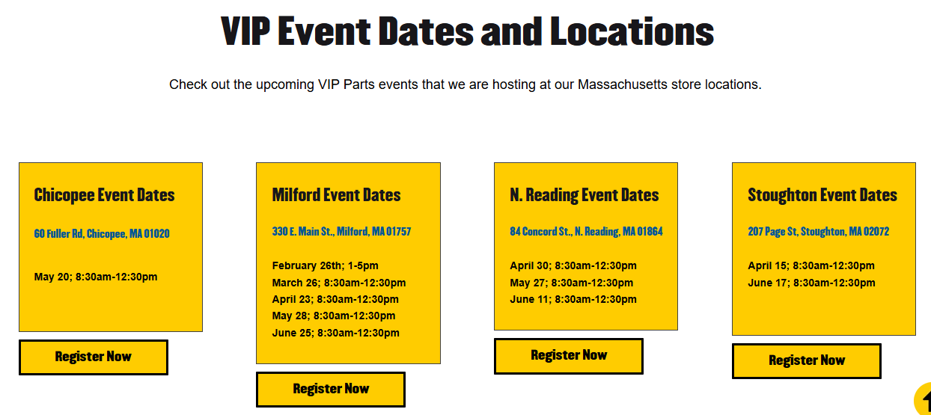
Parts.cat.com / SIS in person trainings
Notes:
If you are interested in attending or sending someone from your dealership to an in-person training based on parts.cat.com and SIS 2.0, please reach out to the parts manage of your local Milton CAT location. Most locations are running these monthly or will be soon. We so appreciate this partnership with our TEPS dealers, and Milton CAT parts is here to support you and your customers. Thank you

