Slide 1
SRE – Service Replacement engines
Steve Moreira
2024

Slide 2
Points for Discussion
Repair Options
  What is Available for repairs, replacements, and warranty
  Advantages between offerings
Tools to help find repair options available.

Slide 3
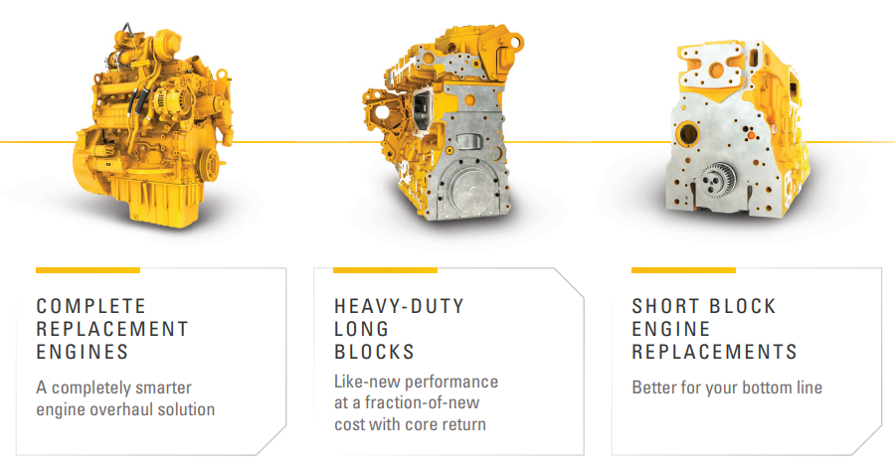
Engine Repair Options – Complete / Long Block / Short Block

Slide 4
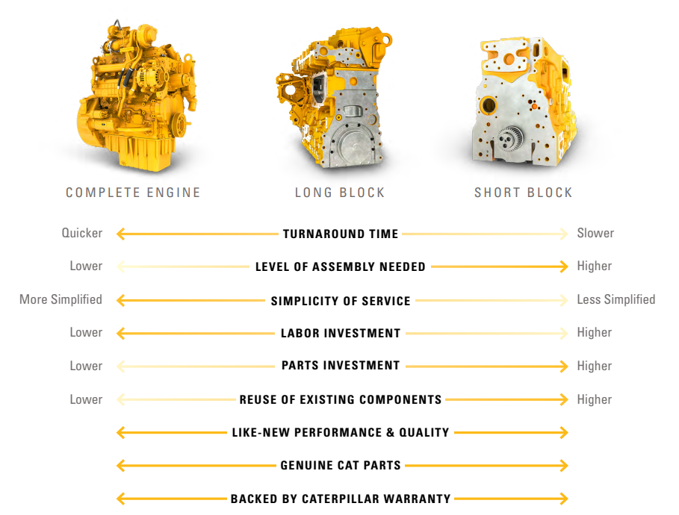

Repair Options – C7.1 and Below
 | Replacement Options | Complete Engines | Long Block | Short Block
C7.1 & Below | NEW
 | REMAN
 | Service Replacement Engines - SRE
C9 & Above | NEW
 | REMAN
Notes:
Link to ID tool on Power Net for Dealers: Engines|Caterpillar
Not all engines are covered, program looked at engine arrangements with a field population over 500 units
The goal of the first SRE project was to provide a SRE for 80% of the field population for C7.1 and below engines in the Tier 3 – Tier 4F range.
There were 358 arrangement numbers on our list. As of May 2022 looks like we we’ll be in the 70% range as some engines that were on our list had already been deleted before we could get an SRE equivalent created.
39 part numbers will be through the Trivium project and those will be available to order around the middle of 2023. The rest will be available to order by the 3rd Qtr of this year 2022.

Slide 5
Short Block, vs. Long Block, vs Complete Engines
COMPLETE ENGINE
LONG BLOCK
SHORT BLOCK
Cat Reman short blocks are fully assembled with a cylinder block, crankshaft, pistons, and connecting rods. They’re a good choice when you have crankshaft or cylinder pack issues, but your cylinder head and geartrain are in good, reusable condition.
Cat Reman long blocks include short block components plus a cylinder head, camshaft and timing gears*. They’re fully assembled and ready to be built into your engine — reducing downtime and labor costs with more Cat Reman factory-built content.
Cat Short Blocks are fully assembled with a cylinder block, crankshaft, pistons, and connecting rods. They’re a good choice when you have crankshaft or cylinder pack issues, but your cylinder head and geartrain are in good, reusable condition.
Cat New and Reman engines are designed to like-new performance and fuel efficiency. Fully assembled and ready to run, they’re a cost-effective replacement solution that helps increase your uptime.
Cat Long Blocks include short block components plus a cylinder head, camshaft, and timing gears*. They’re fully assembled and ready to be built into your engine — reducing downtime and labor costs with more Cat factory-built content.
Cat Reman engines are dynamometer tested and tuned for like new performance and fuel efficiency. Fully assembled and ready to run, they’re a cost-effective replacement solution that helps increase your uptime.
12 Month Warranty
12 Month Warranty
24 Month Warranty
*Depending on model, Cat Reman long blocks may also include an oil cooler, oil pump, water pump and other components.
*Depending on model, Cat Reman long blocks may also include an oil cooler, oil pump, water pump and other components.

Slide 6
Repair Options – C7.1 and Below
CUT DOWNTIME
The power of the Cat Dealer Network leads
to quick engine replacement turnarounds.
COST SAVINGS
Like-new engine performance at a fraction of the cost of a new engine.
GOOD-AS-NEW PERFORMANCE
Each Cat replacement engine is designed for like-new performance. Extended Service Contract available on SREs
SMALL ENGINE OFFERINGS
Cat replacement engine offerings for small engines from 0.5 to 7.1 liters where overhauls are not an option.
Notes:
Link to ID tool on Power Net for Dealers: Engines|Caterpillar
Not all engines are covered, program looked at engine arrangements with a field population over 500 units
The goal of the first SRE project was to provide a SRE for 80% of the field population for C7.1 and below engines in the Tier 3 – Tier 4F range.
There were 358 arrangement numbers on our list. As of May 2022 looks like we we’ll be in the 70% range as some engines that were on our list had already been deleted before we could get an SRE equivalent created.
39 part numbers will be through the Trivium project and those will be available to order around the middle of 2023. The rest will be available to order by the 3rd Qtr of this year 2022.

Slide 7
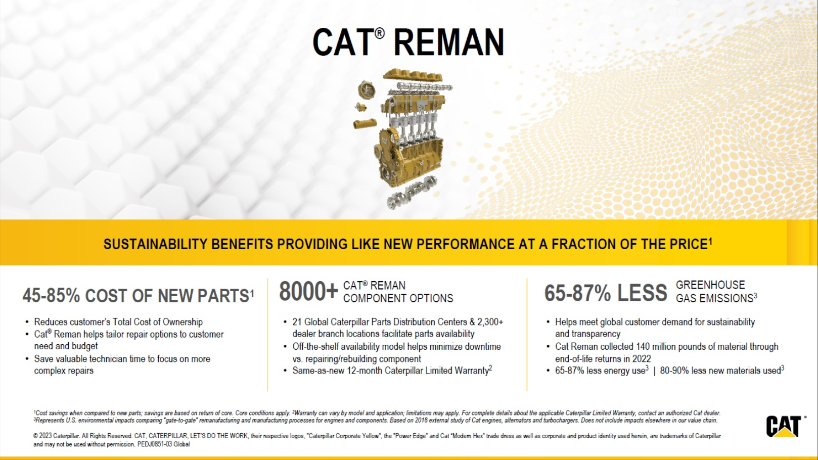

Slide 8
Repair Options – C7.1 and Below
CUT DOWNTIME IN HALF
WHAT ARE THEY?
The power of the Cat Dealer Network leads
to quick engine replacement turnarounds.
CAT® SERVICE REPLACEMENT ENGINES
COST SAVINGS
Like-new engine performance at a fraction of the cost of a new engine.
are an ideal engine replacement option for Cat customers. Caterpillar offers the broadest range of replacement engine options in the industry—including new, used and Cat REMAN full engine replacements.
GOOD-AS-NEW PERFORMANCE
Each Cat replacement engine is designed for like-new performance. Extended Service Contract available on SREs
SMALL ENGINE OFFERINGS
Cat replacement engine offerings for small engines from 0.5 to 7.1 liters where overhauls are not an option.
Notes:
Link to ID tool on Power Net for Dealers: Engines|Caterpillar
Not all engines are covered, program looked at engine arrangements with a field population over 500 units
The goal of the first SRE project was to provide a SRE for 80% of the field population for C7.1 and below engines in the Tier 3 – Tier 4F range.
There were 358 arrangement numbers on our list. As of May 2022 looks like we we’ll be in the 70% range as some engines that were on our list had already been deleted before we could get an SRE equivalent created.
39 part numbers will be through the Trivium project and those will be available to order around the middle of 2023. The rest will be available to order by the 3rd Qtr of this year 2022.

Slide 9
Searching for Repair Options

Slide 10
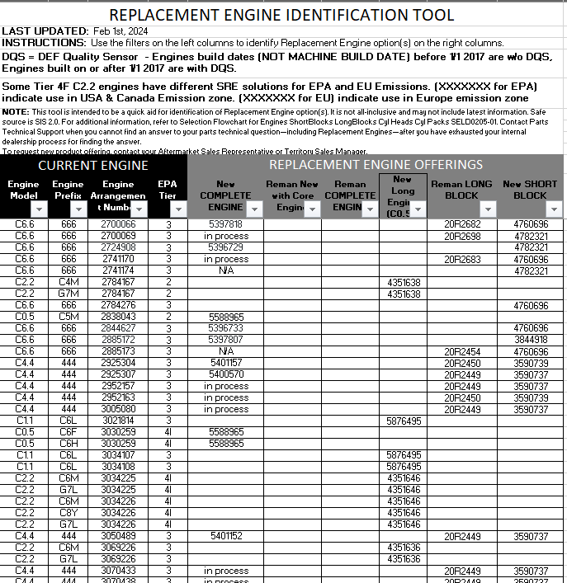
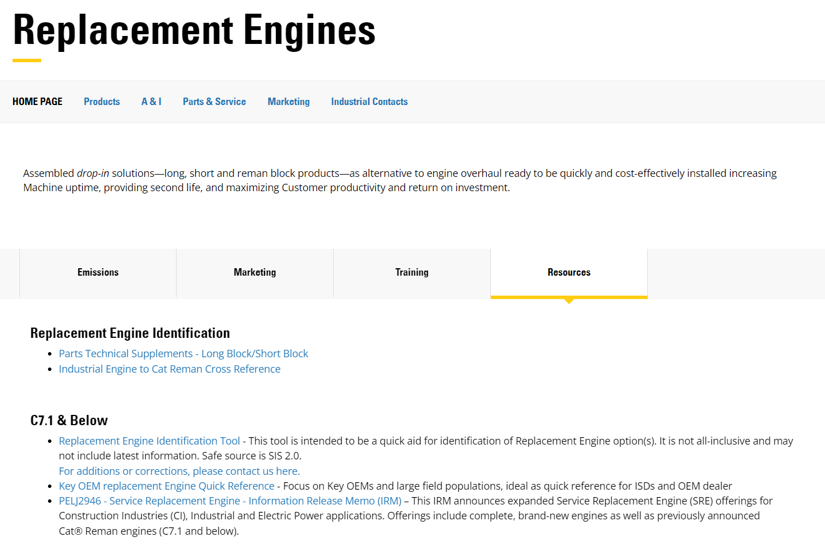
SRE – Replacement Engine Identification Tool
https://catdealer.com/en/products/industries/industrial/parts-service/replacement-engines.html#tabs-9179ffeba5-item-846819be3b-tab

Slide 11
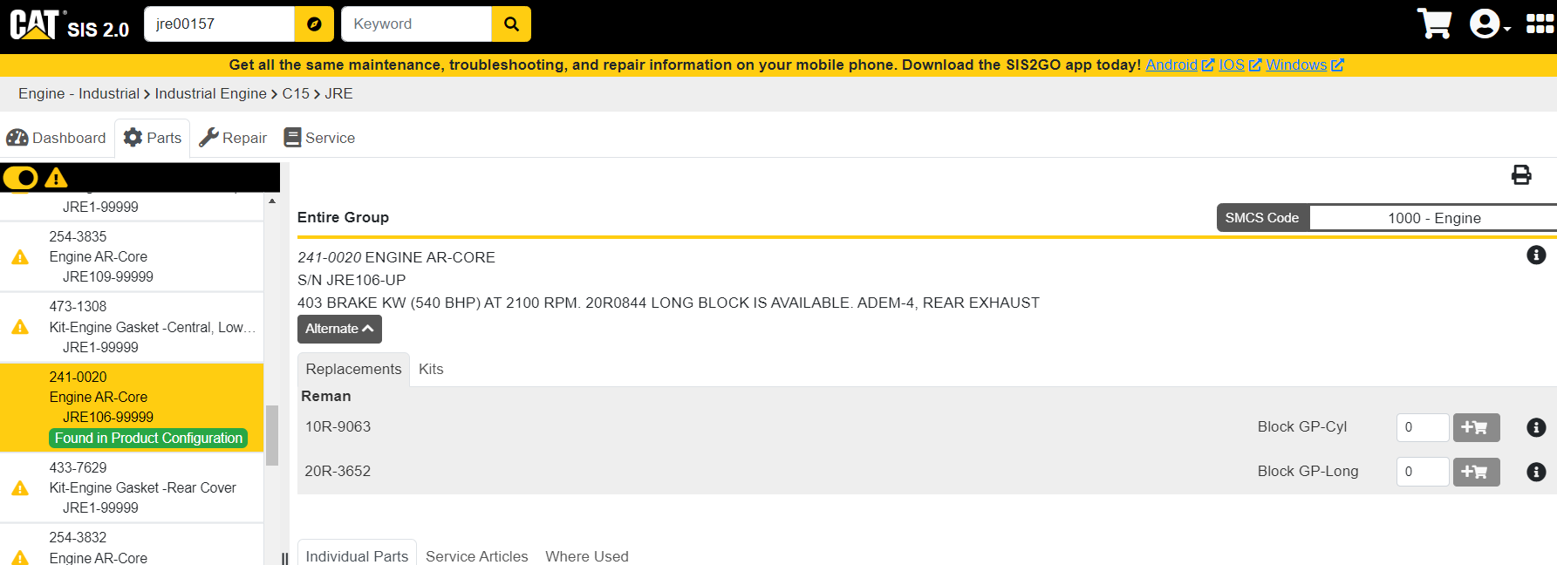
SIS 2.0

Slide 12
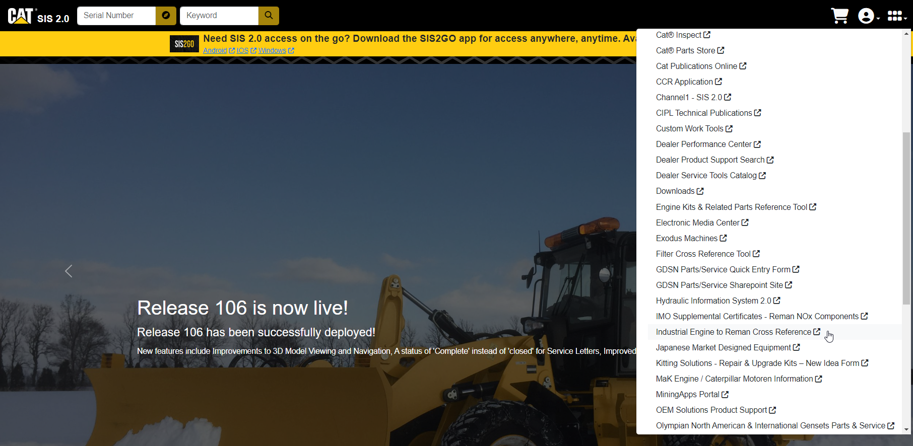
SIS 2.0 – External Links

Slide 13
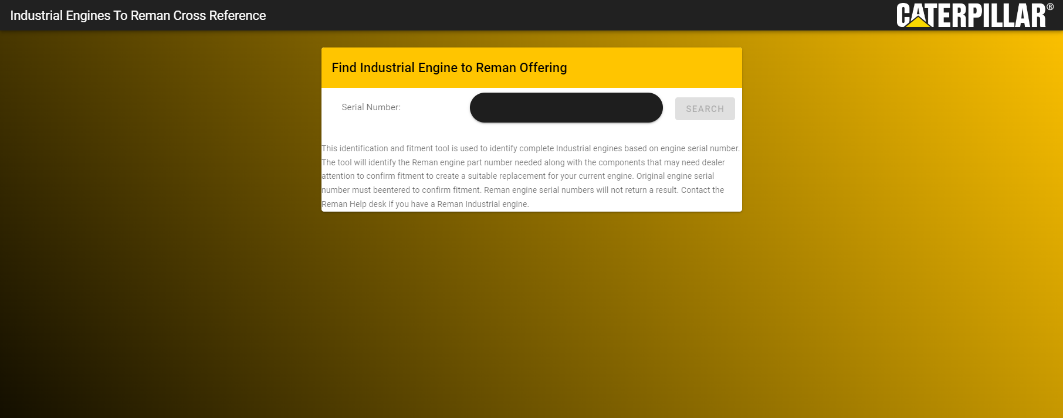
Link – https://indxref2reman.cat.com/IPSDToRemanXRef/

Slide 14
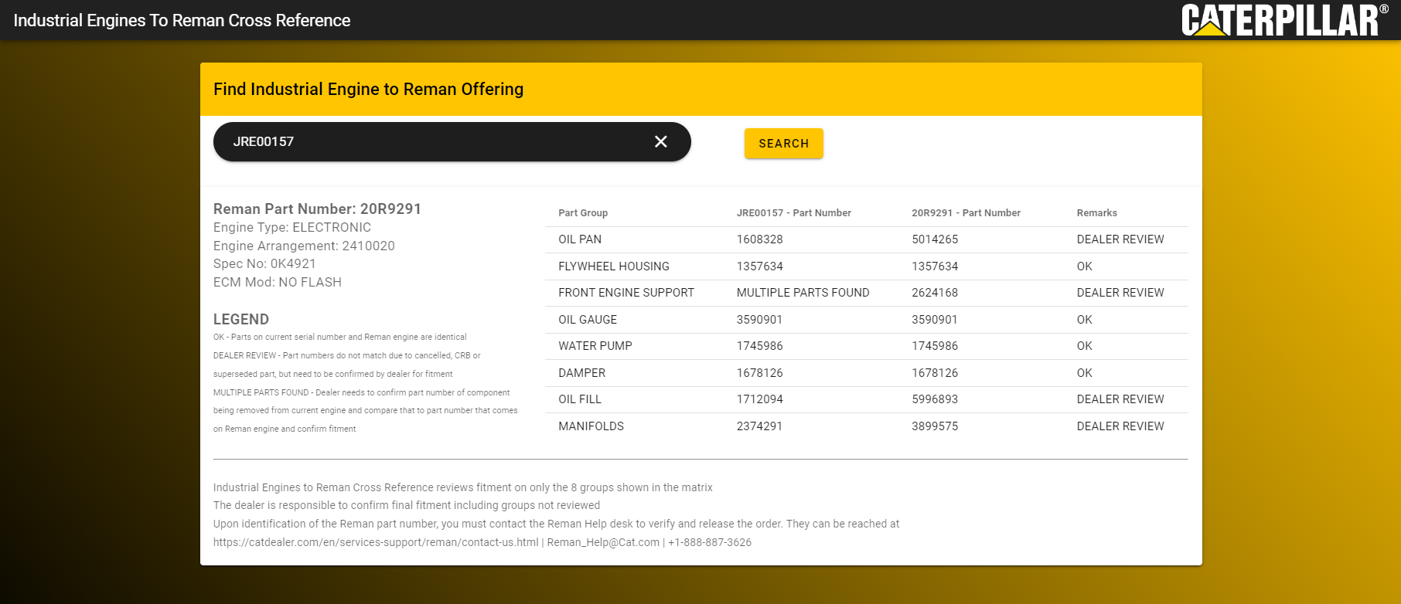
Response with Match
Available Reman Engine

Slide 16
PCC

Slide 17
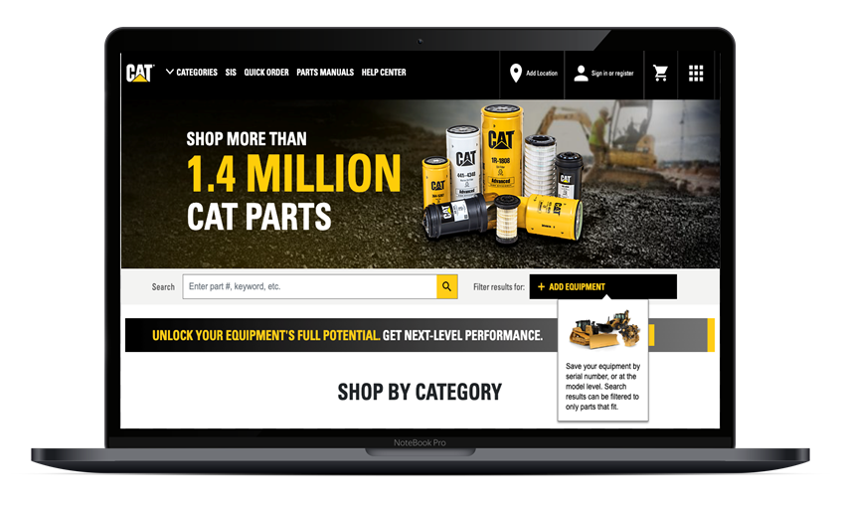
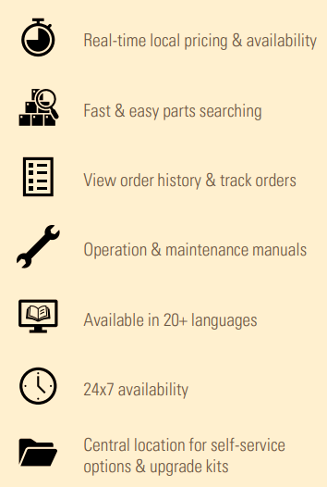
Benefits of Parts.cat.com
EFFICIENCY IN EVERY CLICK
FASTER CHECKOUT
Save Your Primary Engine
  Enter & save your serial/model number to find parts that
  exactly fit your equipment.
Saved Lists
  Create multiple lists for each repair or equipment type
  to stay organized and save time.
Quick Order
  Use part numbers or upload a file to add items to
  your cart and expedite orders.
EASILY MANAGE ORDERS
View Online & Over-The-Counter
  View up to two years of order history.
Core Tracking
  Track the status of returned end-of-life Cat® Reman parts
  for better visibility into your core credit.
Share Cart
  Add items to your cart online and export details for easy
  share with your team or upload to other programs.
CUSTOMIZED FOR YOUR BUSINESS
Personalized Homepage
  Personalize what you want to see when you shop, ensuring the fastest checkout possible.
Notifications
  Customize your order status notification to what you’d like to receive.
Simplify Your Shopping Experience
  Save default preferences to enable a quick login and faster checkout experience with pickup and delivery methods, payment, and more.
ADVANCED PURCHASING FLOWS
Partner Authority Levels
  Purchasing flow functionality enables purchasing managers to administer buyers and approvers, based on purchasing limits.
Partner Quoting
  Create online quotes and freeze a part’s price for a specific duration. When you’re ready to order, activate the quote and send it to a dealer as an actual order
Dealer Quoting
  Dealers can create quotes on behalf of partners within Parts.cat.com for the partner’s review, approval, and activation.
BENEFITS SUMMARY

Slide 18
Improving the ordering process with eCommerce
Using “Saved Lists” for frequently-ordered parts can reduce ordering times and costly mistakes.
Stay up-to-date on order status (i.e. Processing, Shipped, etc.)
View your local dealer’s parts inventory online and shop with confidence.
Assign purchase approval limits to specific team members.
Frequent Order Lists
Tracking Orders
Parts Availability
Authority levels

Slide 19
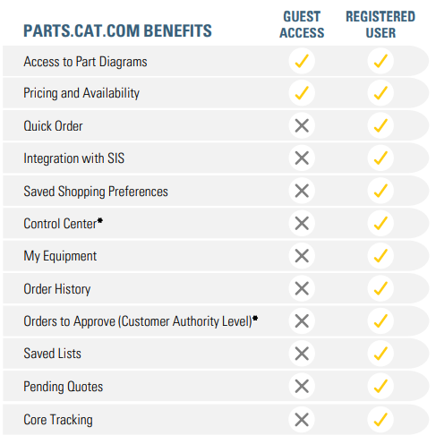
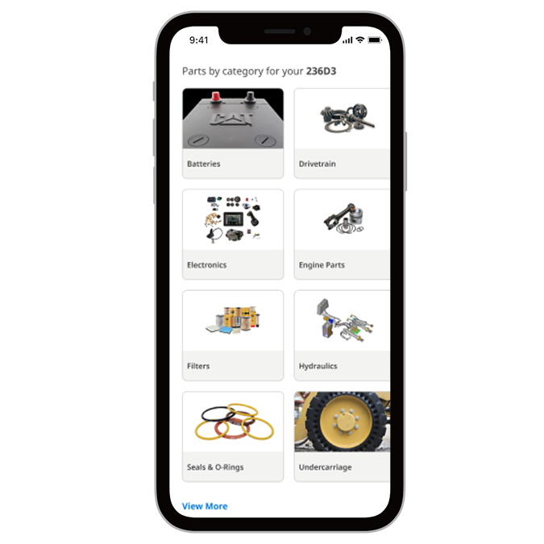
4 EASY STEPS TO GET STARTED
Ordering genuine Cat® parts on Parts.cat.com is fast and easy. Here’s how to get started:
STEP 1
REGISTER YOUR ACCOUNT
Register on Parts.cat.com. You only need to do this once.
STEP 2
ADD YOUR EQUIPMENT
Simply add your serial number(s) to the “Add Equipment” list.
STEP 3
FIND YOUR PARTS
Select “Shop Parts” from the drop-down menu to go to the equipment page for a guaranteed fit.
*TALK TO A DEALER ABOUT ADVANCED FEATURES
STEP 4
Find yourself placing large or frequent orders? Ordering for multiple job sites or technicians? Our advanced features (*) were designed just for you!
  Increase workflow efficiency
  Cart import & export enhancements
  Flexible quoting process, and more!
ADD TO YOUR CART,
HEAD TO CHECKOUT
It’s that easy!

Slide 20
QR Code / Engine Registration

Slide 21
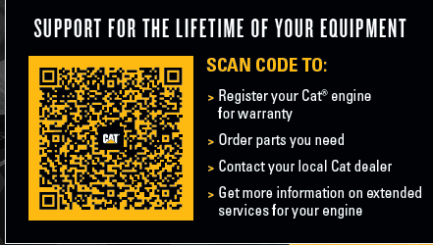
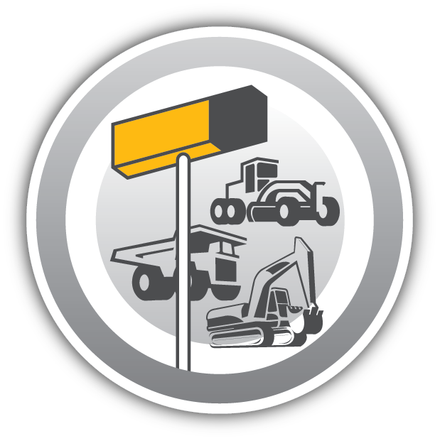




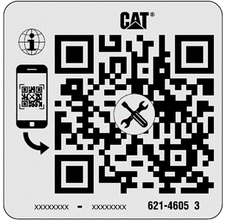
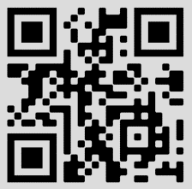


Industrial QR Codes
From (Generic)
Easy Access for OEMD & Customers to Aftermarket Information
Find the Closest Cat Dealer
New Engine Registration
Engine Manuals
SIS2.0 / SIS2GO
To (SN Specific)
Extended Service Contracts
eCommerce / PCC
Notes:
SN SPECIFIC IS CI – NEED TO REPLACE WITH IND

Slide 22
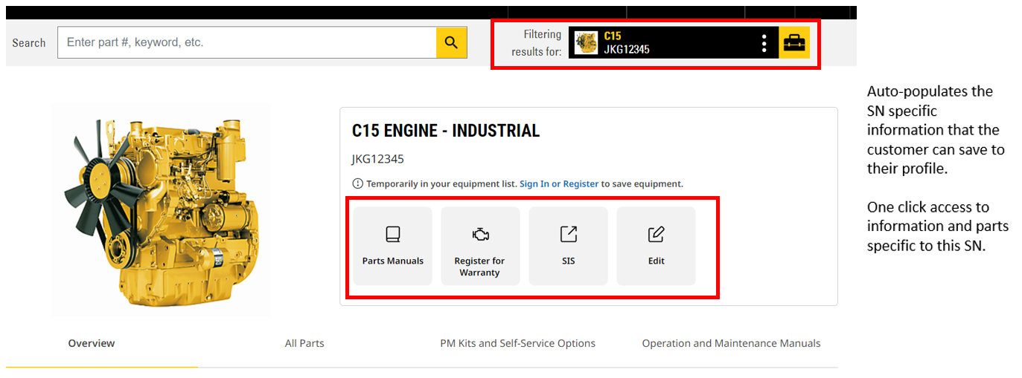
Industrial QR Codes
From (Generic)
Easy Access for OEMD & Customers to Aftermarket Information
Find the Closest Cat Dealer
New Engine Registration
Engine Manuals
SIS2.0 / SIS2GO
To (SN Specific)
Extended Service Contracts
eCommerce / PCC
Notes:
SN SPECIFIC IS CI – NEED TO REPLACE WITH IND

Slide 23
DPC

Slide 24
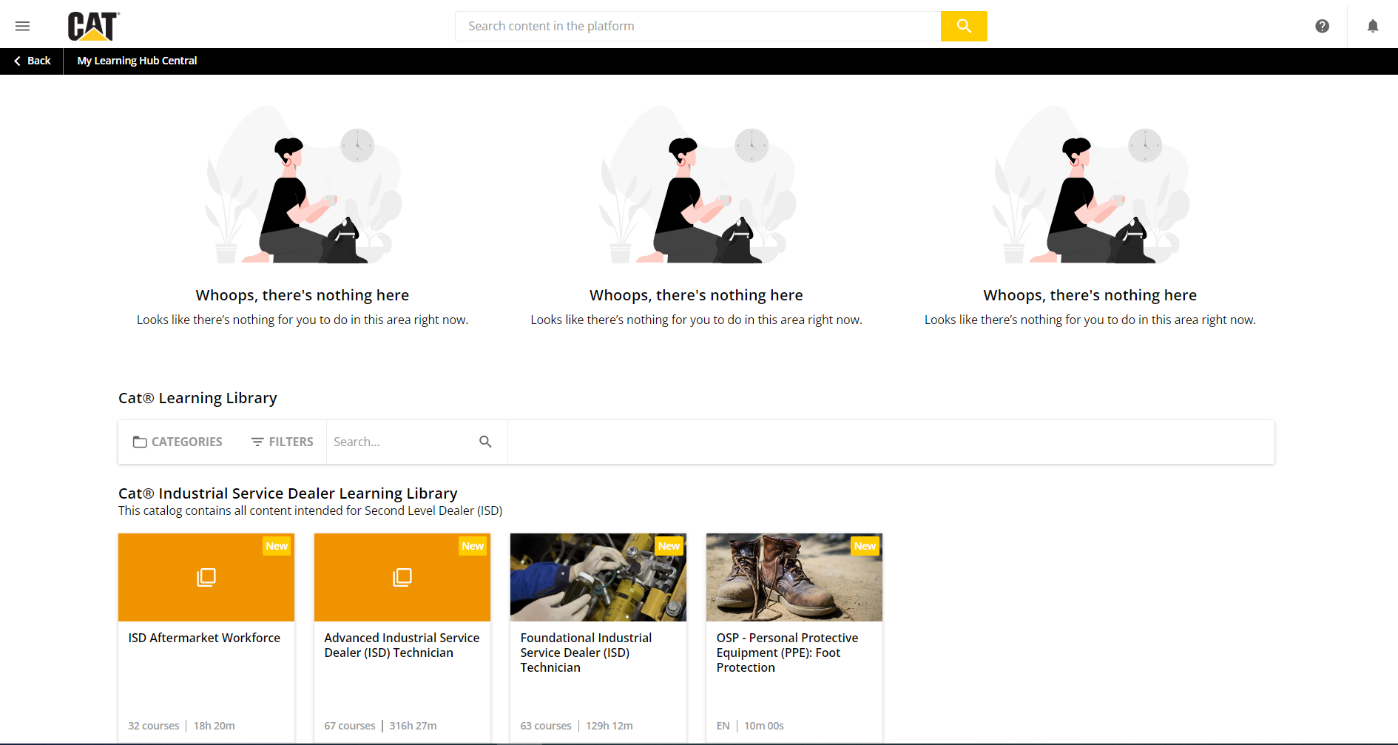
DPC – Online Training Platform
https://catdpc.docebosaas.com/dealers

Slide 25
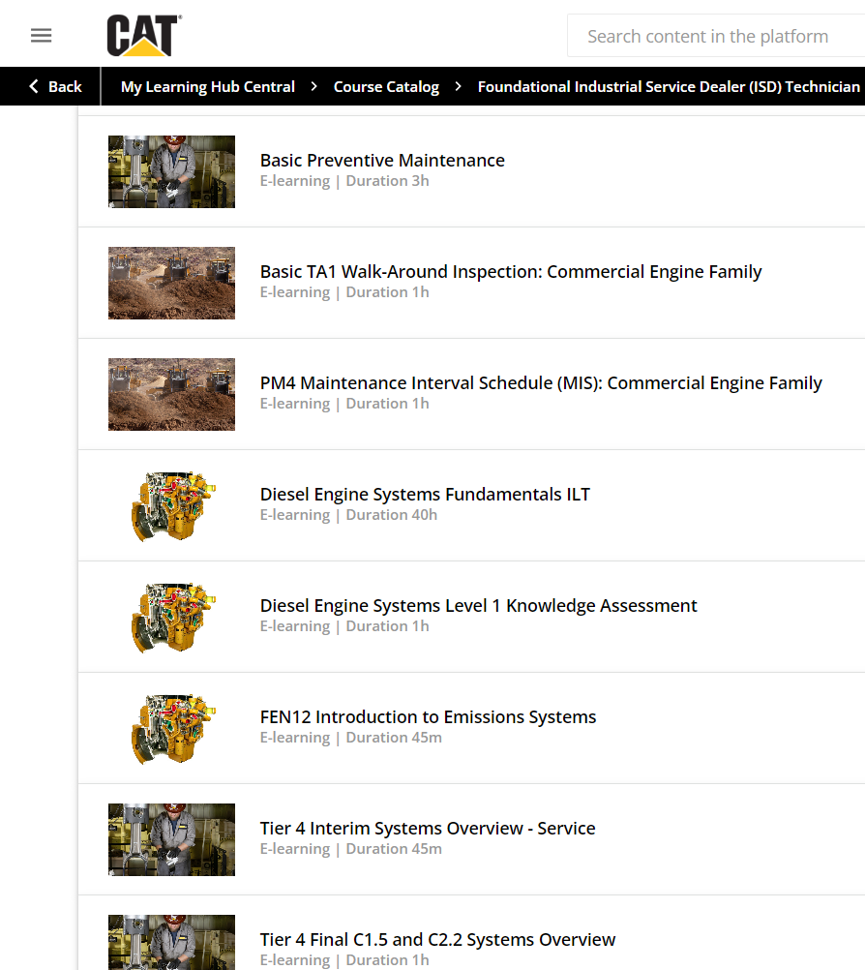
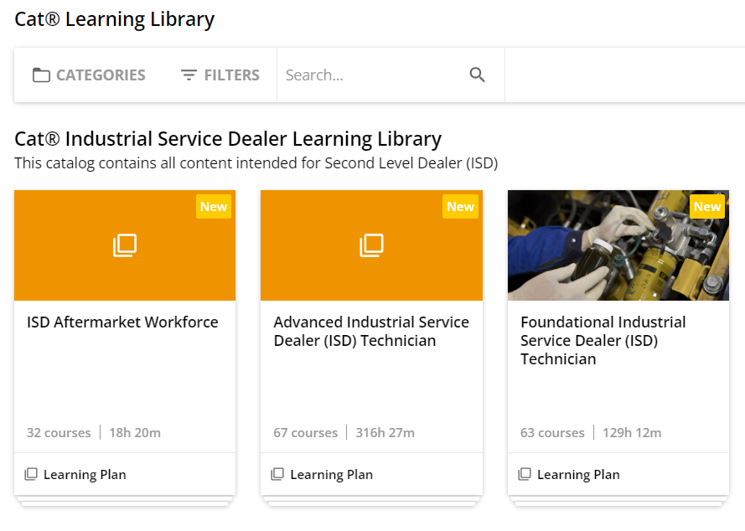
DPC – Foundational ISD Technician

Slide 26
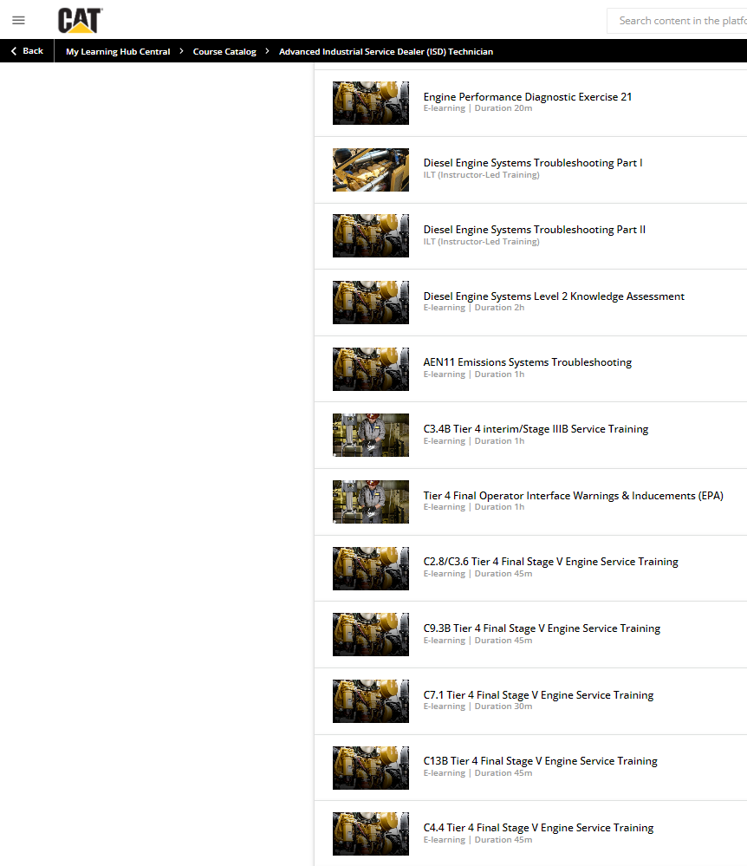
DPC – Advanced ISD Technician

Slide 27
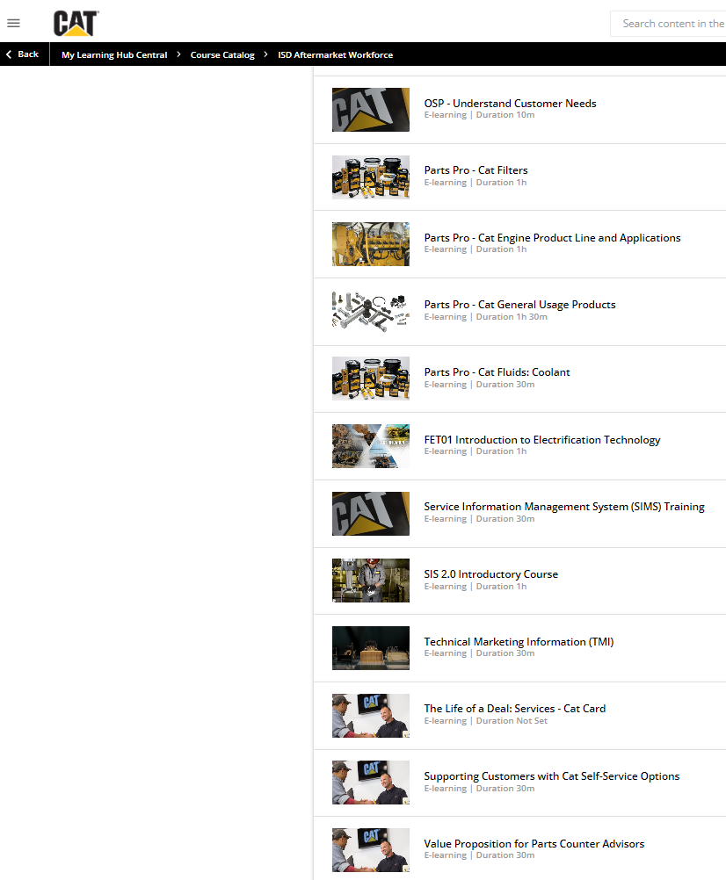
DPC – ISD Aftermarket Workforce

