Slide 1
Product news New Product Introduction
MC Industrial and Marine Group

Slide 2
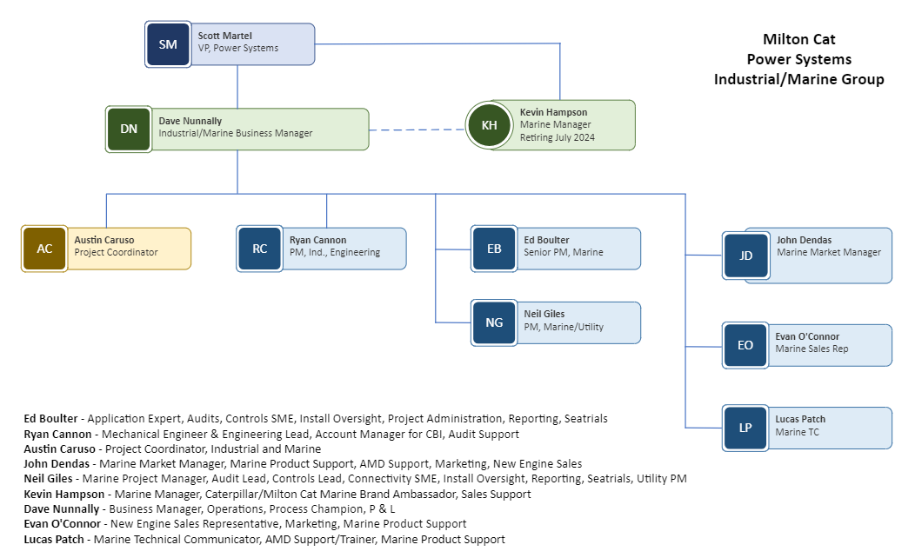
Organization

Slide 3
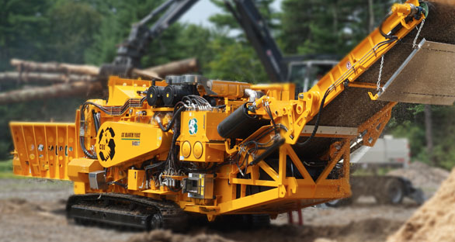
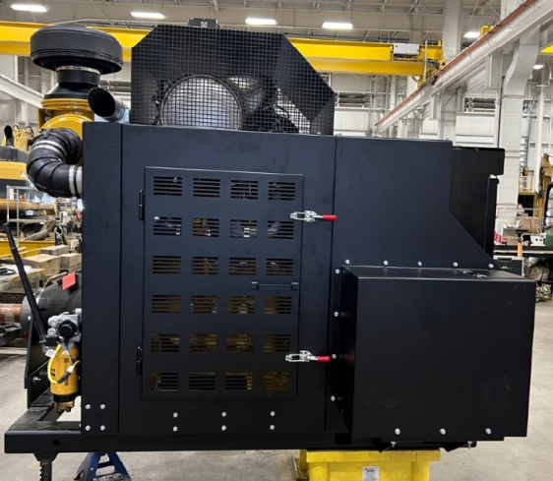
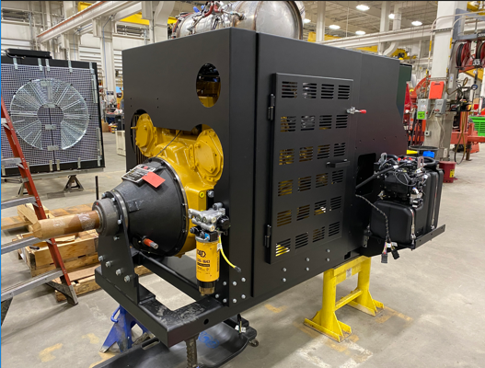
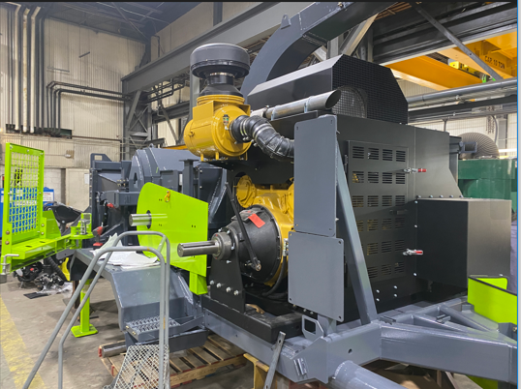
CBI Terex
Services Provided:
Currently producing 80 assemblies / year
C9.3B thru C32 IPU Manufacturing/Packaging
Application audits
Engineering Support
Installation Support
New Engine Sales
Production schedule, planning, inventory management
Product support
TVA procurement and support
Warehouse and manage customer supplied product
Radiators/ Clutches/Fans/Couplings
CBI/Terex C27 IPU, built in Londonderry, NH
MC Designed & Fabricated C9.3B IPU for new model 790 chipper

Slide 4
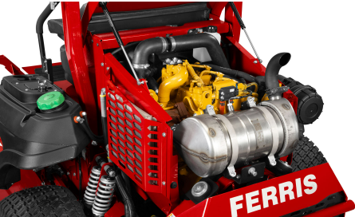
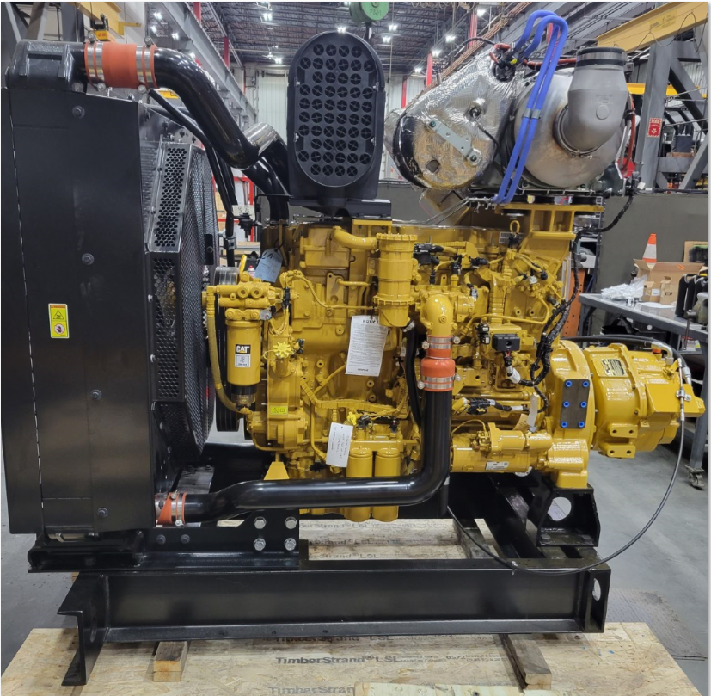
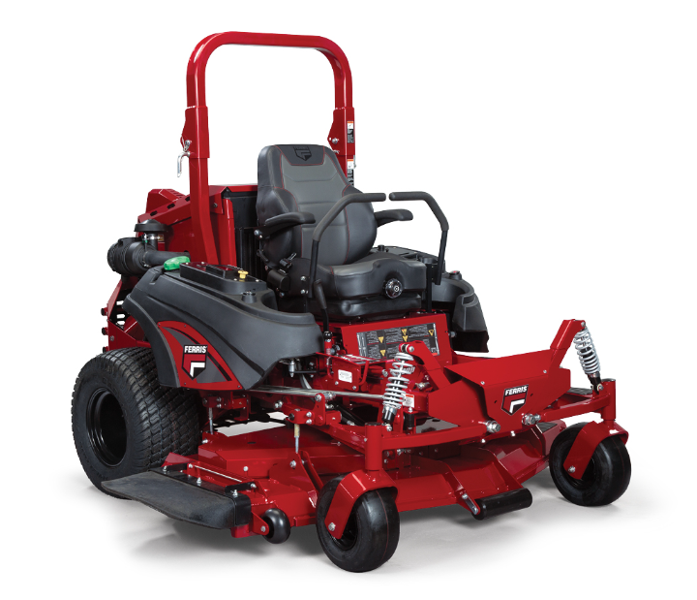
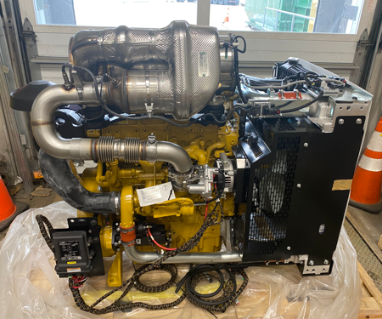
Various Projects
Ferris IS-6200 Commercial Zero Turn
Cat C1.7
Waste Treatment Roots Blower Replacement Engine
C13B IPU, Twin Disk Transmission, MC designed frame
C4.4 IPU for Inland waterways vessel
MC installed LOR power distribution

Slide 5
Product Lineup
Industrial Engine Rating Guide LEBH-0002

Slide 6
Product News
C2.8, C3.6, C4.4, C7.1 WIF Sensor Change – LEXH22453
New sensors to replace existing.
C3.6, C2.8, C3.3, C4.4 Alternator Change – LEXH21471
Part consolidation, 4 to 2.
C2.8 IPU package mounted ECM – LEXH21906
ECM now mounted on radiator with harness installed
C3.6, C4.4 DEF Line Change – LEXH21519
Product improvement, new lock mechanism, cable change, hose diameter increase
Ratings Guide – LEGH0002
Download current version, changes frequently

Slide 7
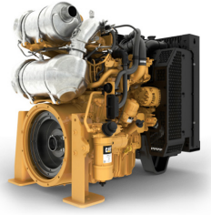
New Product Introduction – C1.7, C2.2, C2.8, C3.6 IPU, Stage V
New Industrial power units are now available
C1.7T
36 kW (48 hp) @ 2800 RPM
C2.2T
36.4 kW (49 hp) @ 2800 RPM
45 kW (60 hp) @ 2800 RPM
C2.2TA
45 kW (60 hp) @ 2800 RPM
50 kW (67 hp) @ 2800 RPM
55 kW (74 hp) @ 2800 RPM
C2.8T
55 kW (74 hp) @ 2400 RPM
C3.6TA
86 kW (115 hp) @ 2200-2400 RPM
100 kW (134 hp) @ 2200-2400 RPM
IPU’s are now available across the entire product lineup, see rating guide LEGH0002 for details

Slide 8
C1.7
C2.2

Slide 9
C2.8, C3.6

Slide 10
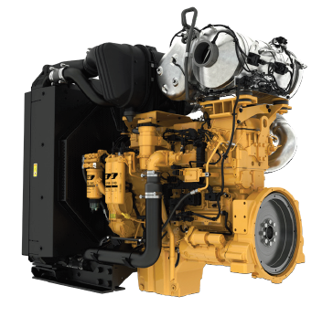
New Product Introduction – C13D

Slide 11
New Product Introduction – C13D

Slide 12
New Product Introduction – C13D
Specifications
Availability

Slide 13
New Product Introduction - C13D Ratings

Slide 14
New Product Introduction - C13D Comparisons

