Slide 2


IPSD SAFETY BRIEFING
.
WORKSPACE:
Room Hazards and Exits
Identify and resolve potential slip, trip, fall and other room hazards
Locate the emergency exits
Emergency Reminders
Know your local Fire / Medical emergency numbers
Locate the facility CPR / AED / First Responders & Aiders
Know your Take Cover Location / Evacuation Plan
Whether you work from a Caterpillar facility, remote or traveling, please keep safety top of mind.
PERSONAL:
Mental Health
Take breaks throughout the workday
Ask for help when needed
Create a routine that works for you
Physical Health
Create an ergonomic workspace
Move around when possible
Camera:
ON / OFF
Interaction:
Free to Speak
Raise Hand
Teams Chat
CYBER:
Report any suspicious emails or activity
Create unique passwords
Use correct confidentiality labels (Caterpillar Green, Caterpillar Yellow, Caterpillar Red) on documents, emails and projects
Align with proper security standards

Slide 3


THIS MEETING IS BEING RECORDED
EP 1:37 related approvals were acquired prior to this meeting.
Your presence in this meeting provides your consent to be recorded.
If you do not wish to be recorded, please exit the meeting now.
Feel free to participate during appropriate discussion – otherwise, please mute your computer or phone.

Slide 4
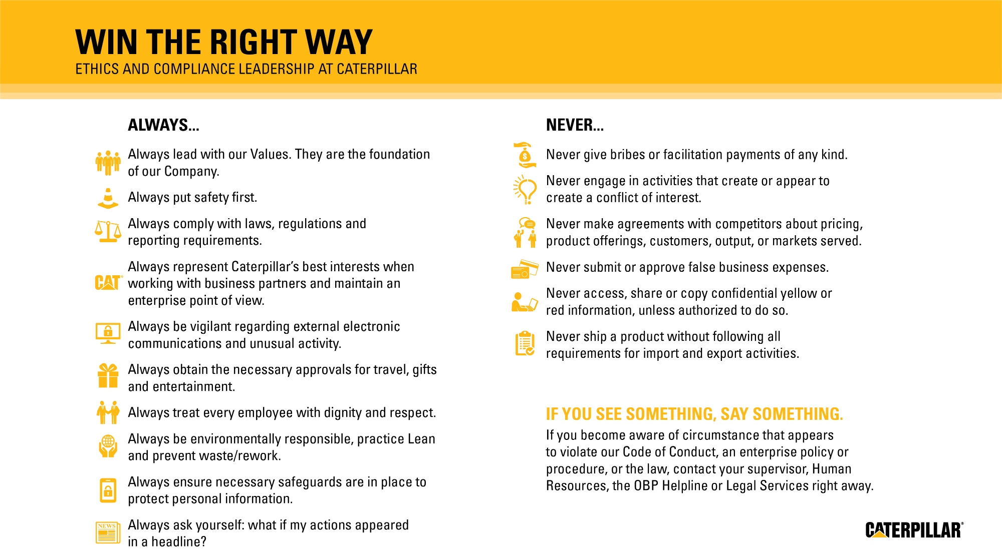
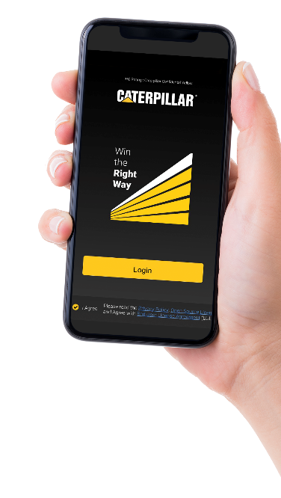
Download
Win the
Right Way
App

Slide 6
Cat Card | Cat Card Rewards

Slide 7

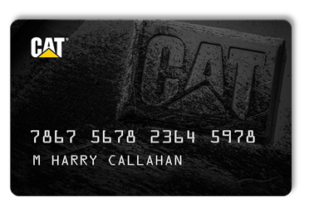
What is the Cat Card?
Provides an unsecured line of credit for customers
Accepted at all US and Canada Caterpillar dealers
National Program- One statement, one payment per month
Access to 0% programs and other special financing options
Provides financing for parts purchases
Managed by a dedicated Cat Financial team
Notes:
The Cat Card is a card that:
*Provides an unsecured line of credit for Cat customers
*Is accepted at all US and Canada Caterpillar dealers and Cat Rental Stores – no collateral or lien required, so the application process is simple with a quick turnaround
*The Cat Card is a national Program. One statement, one payment per month for all charges including those from multiple dealers. Can also set up sub-accounts with credit allocation to manage charges. Customers may choose either statement or invoice billing.
*Gives Customers access to 0% programs and other special financing options – now and in the future!
*Almost anything sold by Cat Dealers and Cat Rental Stores can be charged to the customer’s Cat Card. It’s not accepted for new Cat construction equipment, but Cat Financial is always ready to handle customer’s machine financing needs
*Finally, Cat Card is managed by a dedicated Cat Financial team.

Slide 8
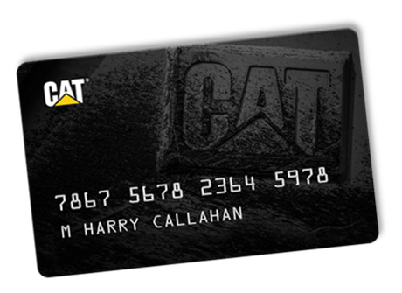
ISD Dealer Benefits
Program to earn REWARDS and streamlined redemption process
Assigned VIP Account Manager
No finance charges if paid in full each month
Online access to account/payment information
Access to special financing options
NO ANNUAL FEE
45 day terms
Keeps bank lines open
Customized billing/statements, one payment per month for all charges including from multiple dealers.
Ordering process doesn’t change; phone, PCC, etc.
Receive warranty payments through Cat Card to speed up claims process

Slide 9
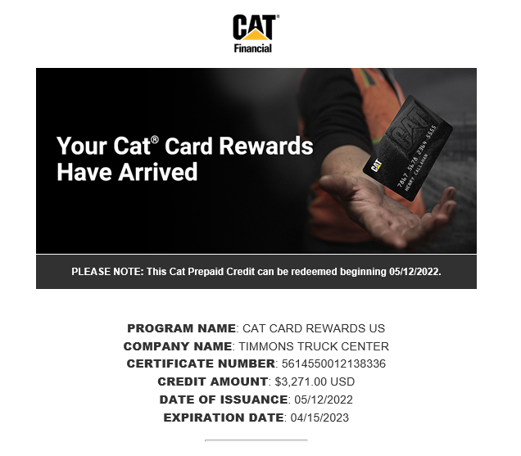
Cat Card Rewards
Earn 1% rewards on all purchases
Receive rewards as Cat Credit
Can be used as a Statement Credit or for future parts/services/rental.
Can redeem starting at 25 rewards
Automatic enrollment in the program
Can be used at dealership, PCC, and Cat Central

Slide 10
How does the transition to Cat Card work?
Credit approval
- Complete credit application
- Provide Financials (if required)
Once approved account is set up in Cat Card system
Conference call held with you, Cat Dealer(s), & Cat Card VIP rep.
- transition date(s)
- billing cycle preference (you can pick your due date)
- account structure
- overview of billing process and monthly statement
- warranty payment option
- contact information

