Slide 1
ISD Dealer Days
Presenter Name: MARLON SAIZON
Topic: PARTS AVAILABILITY & ORDER FULFILLMENT

Slide 2
Agenda
Order Types
Availability
Backorder Priority
Escalation

Slide 3
TOPIC: Parts Order Types
Planned Order Types

Slide 4
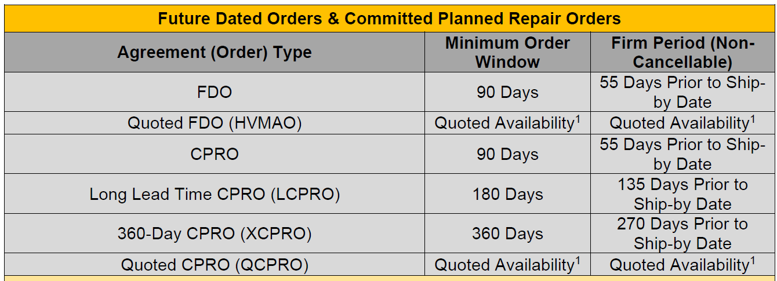
TOPIC: Planned Order Types

Slide 5
Availability – Terminology
Supplier Lead Time
ESD - Estimated Ship Dates
MAO – Made As Ordered
Constrained Parts
Constrained Parts Lists
Mandatory Planned Orders List
QCPRO – Quoted CPRO
LCPRO – Long-Term CPRO
XCPRO – Extended
Highly Constrained
Serialized CPRO (requires serial number)
Frozen
Allocation
Quality Freeze

Slide 6
Backorder Priority

Slide 7
Availability & Escalation Process
Availability
Milton stock
Local CAT facing facility (York, PA)
Other CAT distribution centers
DPIS – Dealer Parts Inventory Sharing
The hook-up (call friends at other CAT dealers)
Escalation
Milton CAT Parts Department
Have to ask to ‘open a case’
3 levels of escalation
Follows backorder priority

Slide 8
Summary
Parts.Cat.Com for stock orders to Milton CAT as much as possible
Work with Milton CAT on planned orders where needed
Regular stock (FDO)
Known major repairs at a future date (CPRO)
Constrained
High priority backorders – ask Milton CAT to escalate/open a case
Committed Planned Replacement Orders (CPRO, LCPRO, QCPRO, XCPRO)
Machine Down

Slide 9
General Discussion / Questions

