Slide 1
ISD Dealer Days
Presenter Name: MARLON SAIZON
Topic: MARKETING SUPPORT PROGRAMS; ENGINE KITS & RELATED PARTS TOOL

Slide 2
Agenda
Market Support Programs

Slide 3
Market support programs

Slide 4
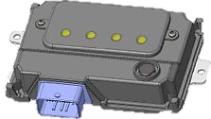
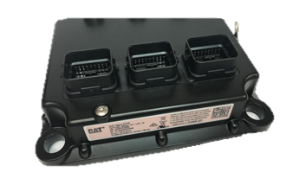
ISD’s/OEM Dealers Support Programs
Engine Repairs & Overhauls
Maintenance
Aftermarket Services
ISD
Connectivity
Additional 14.5% off maintenance parts
Hardware & Sub Support
NAT-MLP-4861 US
NAT-MLP-5077 US
NAT-MLP-5078 CAN
NAT-MLP-5983 CAN

Slide 5
ISD
Up to 14.5% off DN!
INSERT IMAGE
ISD - Industrial
Valid through December 31st, 2024
Program Numbers: NAT-MLP-4861 (US) /
Description: ISD Stock Up Program, 14.5% Max DN, USA
Applies to:
ISDs buying from Cat Dealer
Over the counter
Terms & Conditions
The program offers 12.5% discount off AMD or ISD Net Price on:
Cat Fuel Filters, Cat Coolant , Antifreeze and Cat Premium High Output / GSL Batteries for stock orders only
This program will work with electronic orders and call-in orders as long as AMD/ ISD customer code in DBS is set to recognize the program ID in PSCS
In the Code Maintenance Table of DBS the Dealer Net discount will be 14.5%
Cannot to be combined with other programs.
Excludes CAT Machine, O&G, and EP

Slide 6
General Discussion / Questions

