Slide 1
ISD Dealer Days
Presenter Name: Chris Cipperley
Topic:SIS 2.0

Slide 2
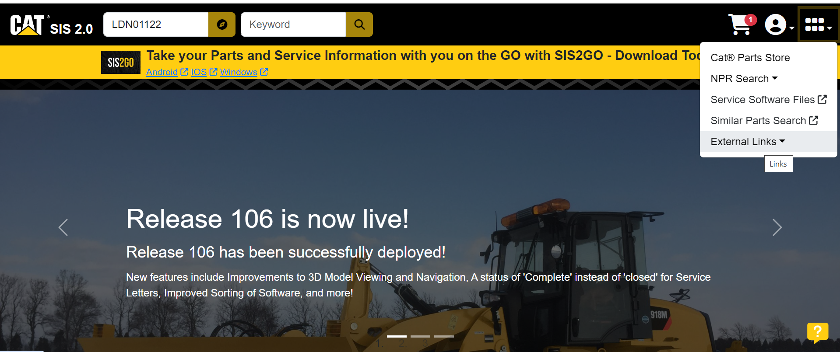
MAIN PAGE EXTERNAL LINKS

Slide 3
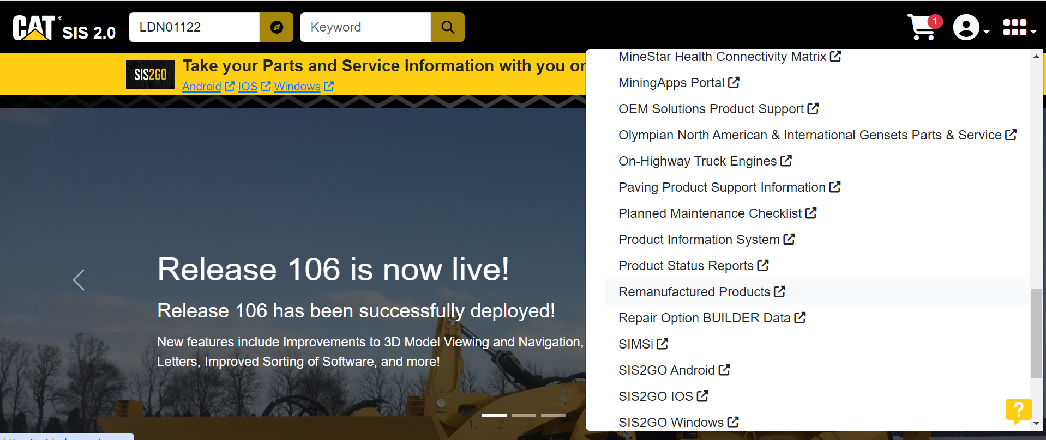
REMANUFACTURED PRODUCTS

Slide 4
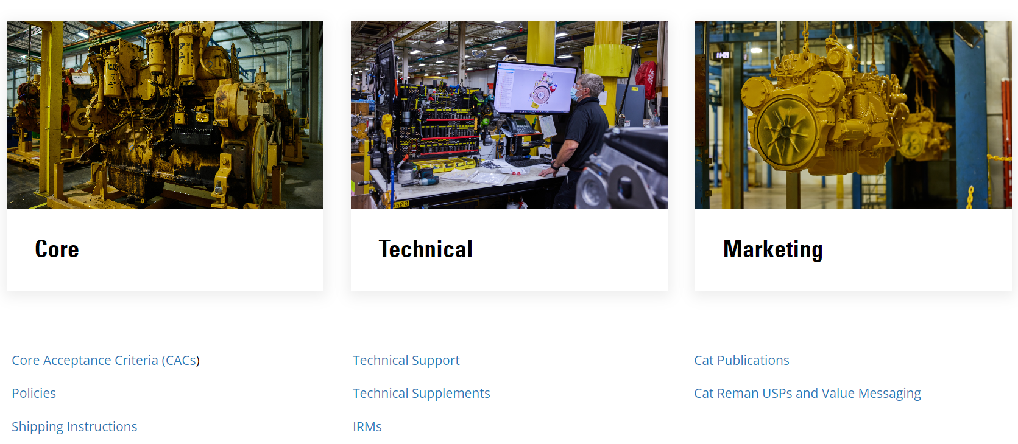
CAC’S (CORE ACCEPTANCE CRITERIA)

Slide 5
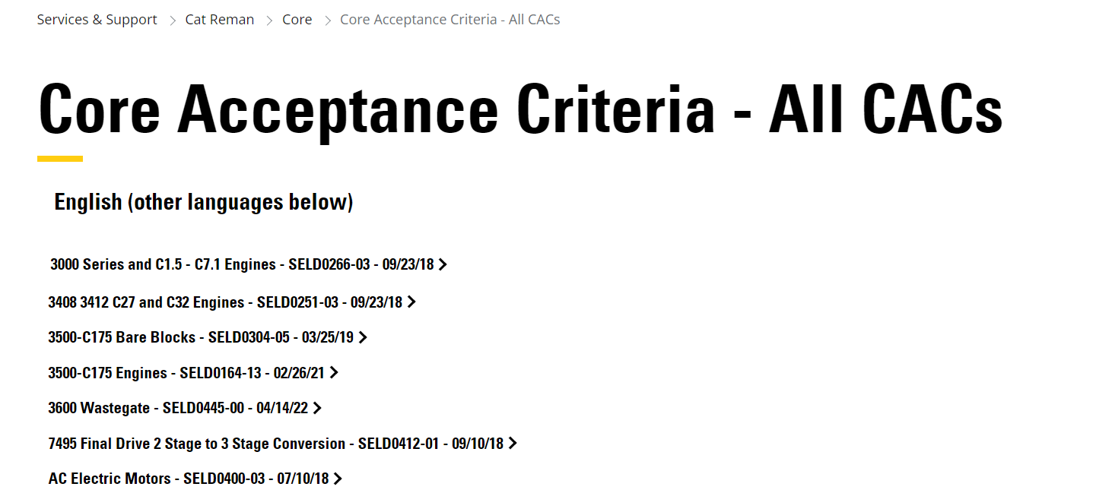
AIR COMPRESSOR CORE CRITERIA

Slide 6
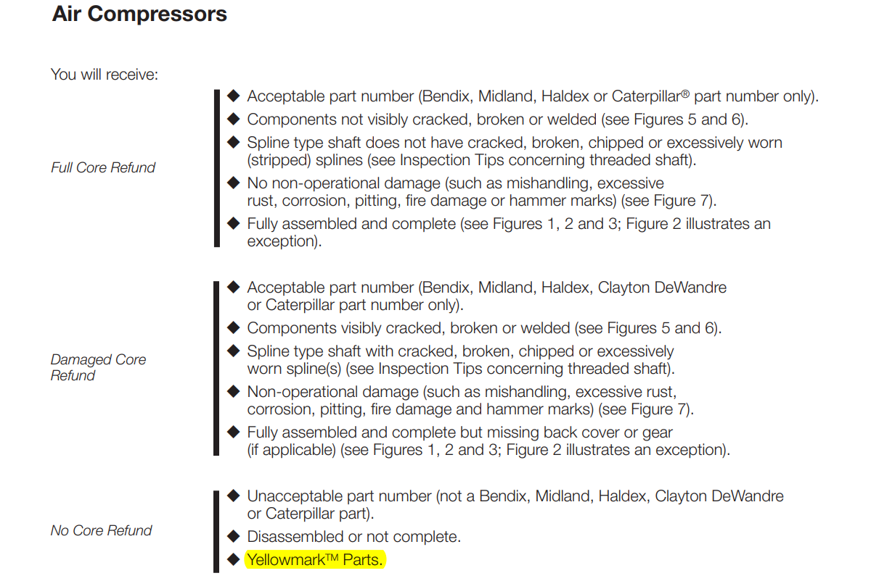
CORE REFUND LEVELS

Slide 7
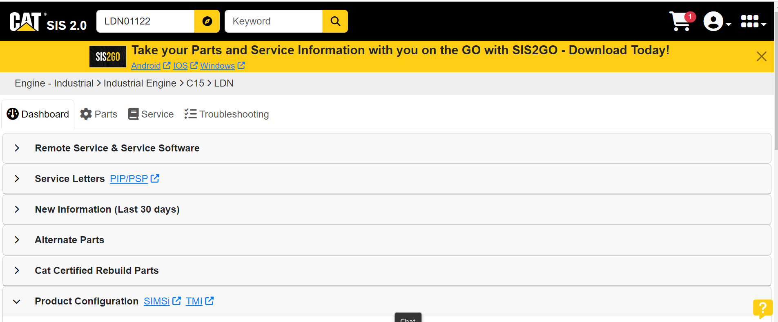
INFORMATION LANDING PAGE

Slide 8
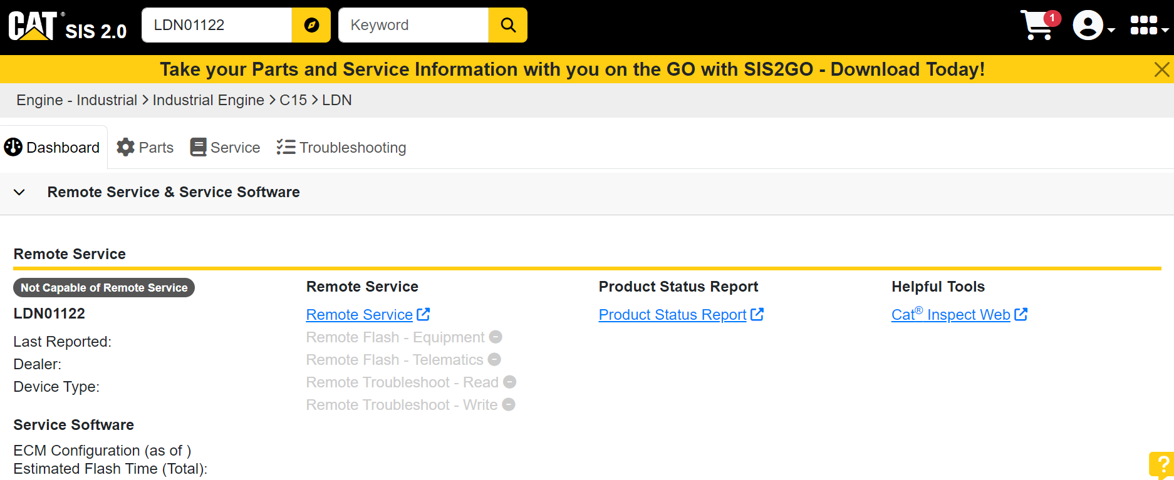
REMOTE SERVICE TAB

Slide 9
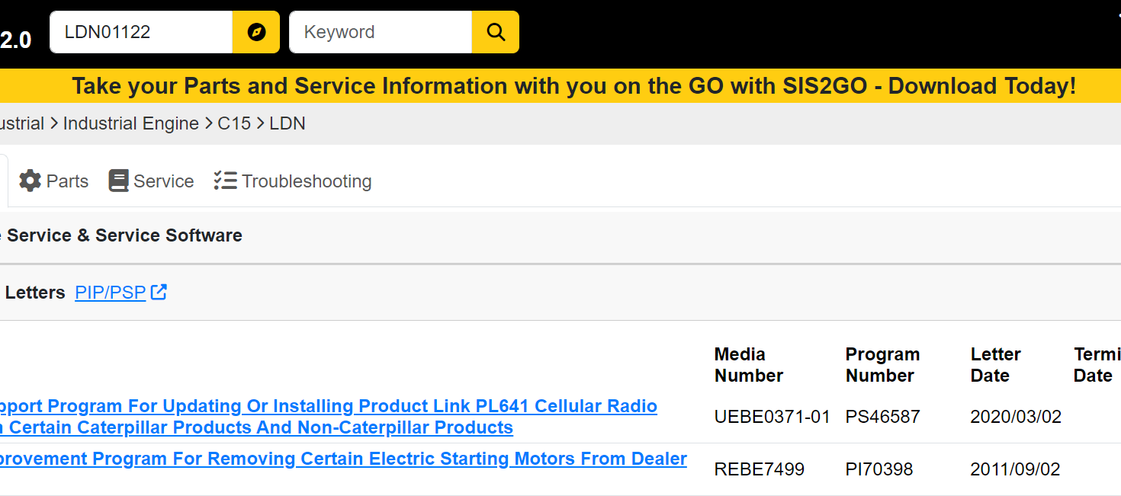
SERVICE LETTERS TAB

Slide 10
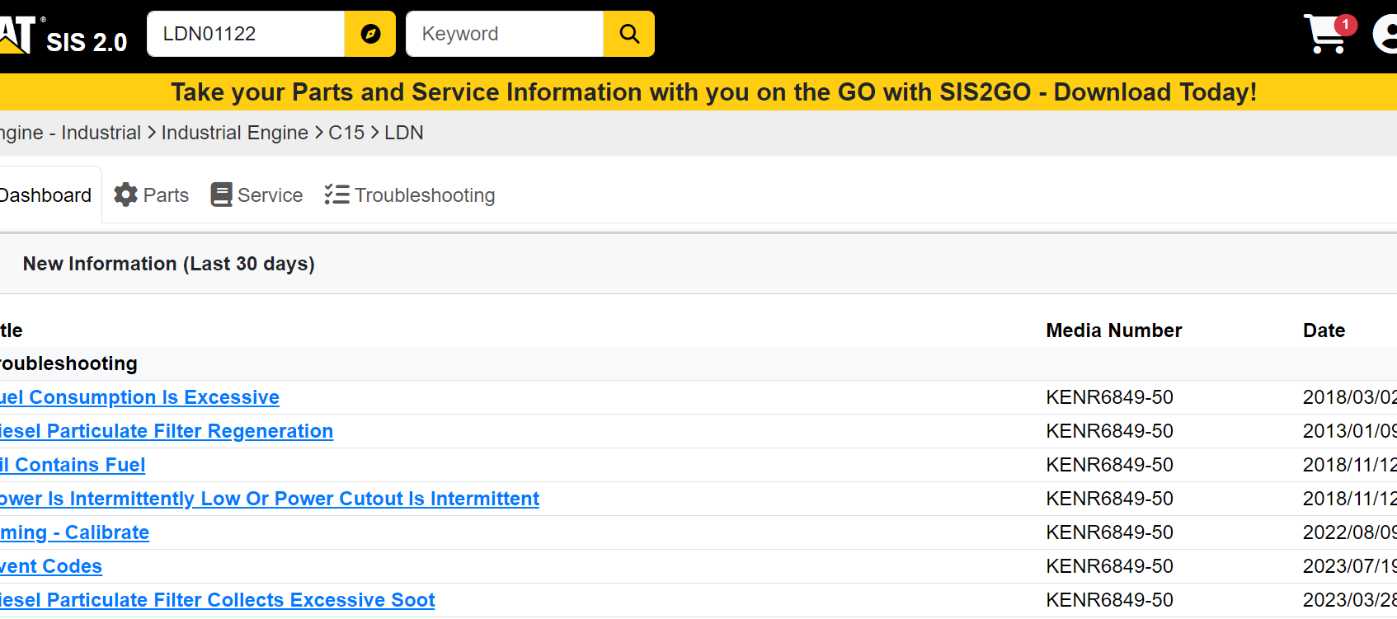
NEW INFORMATION TAB

Slide 11
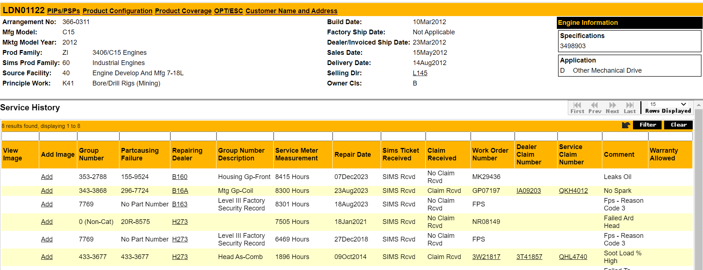
SIMSi LINK

Slide 12
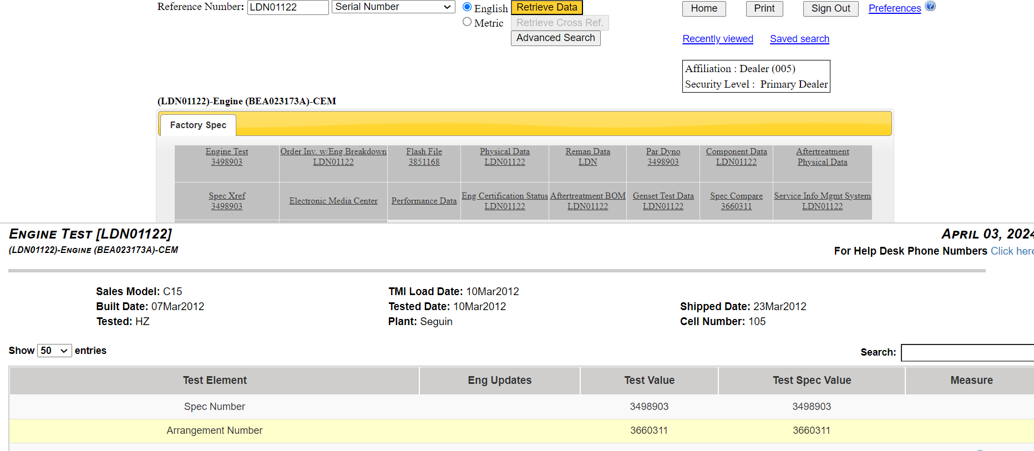
TMI LINK

Slide 13
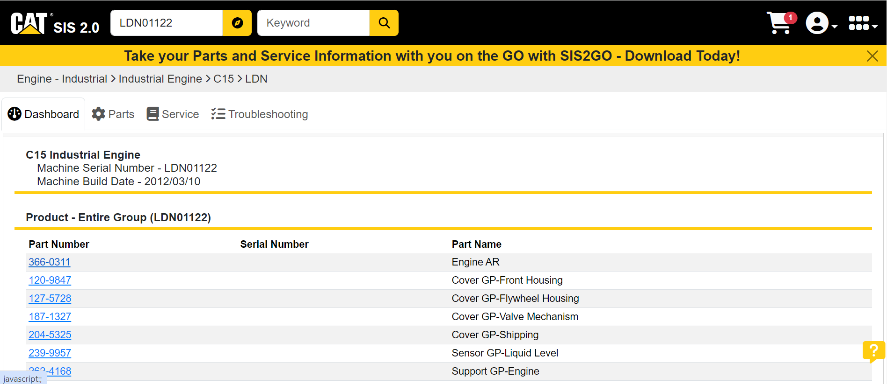
ENGINE CONSIST/BREAKDOWN

Slide 14
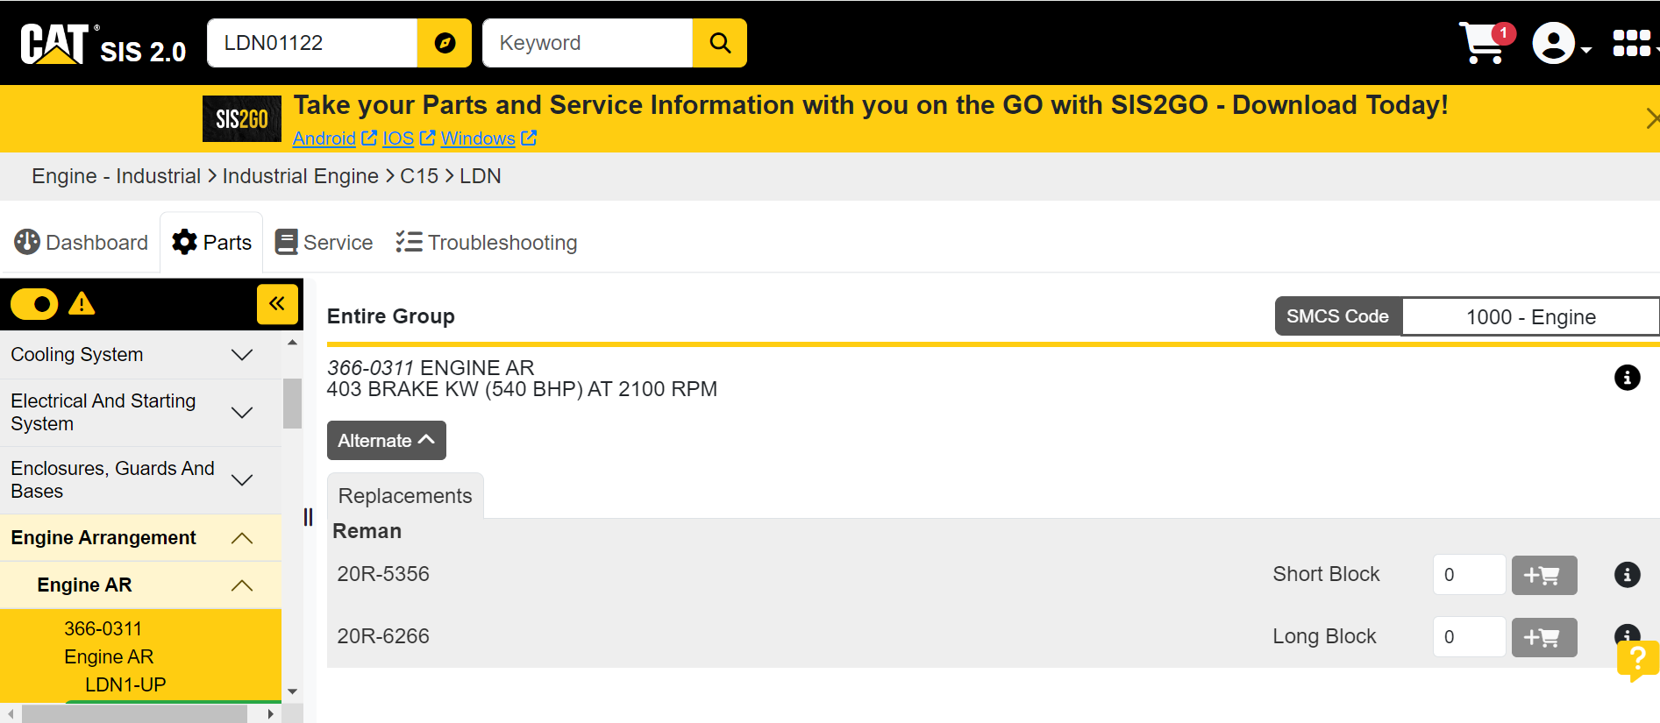
ALTERNATE PART TAB

Slide 15
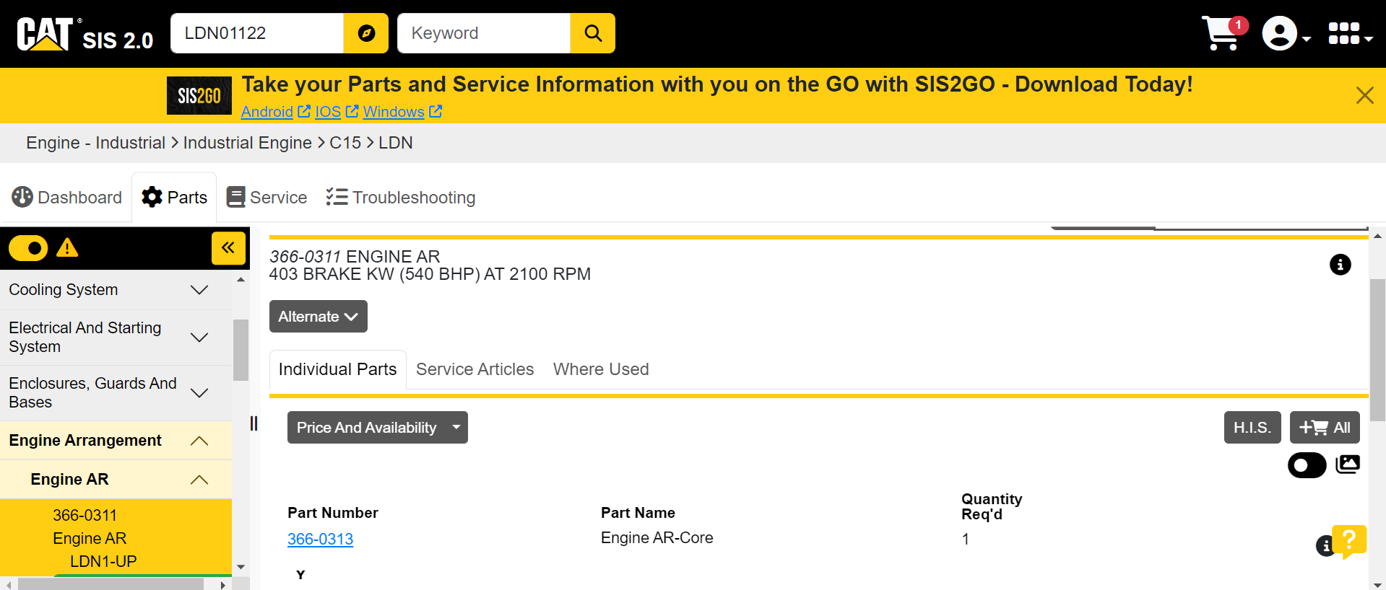
ENGINE ARRANGEMENT

Slide 16
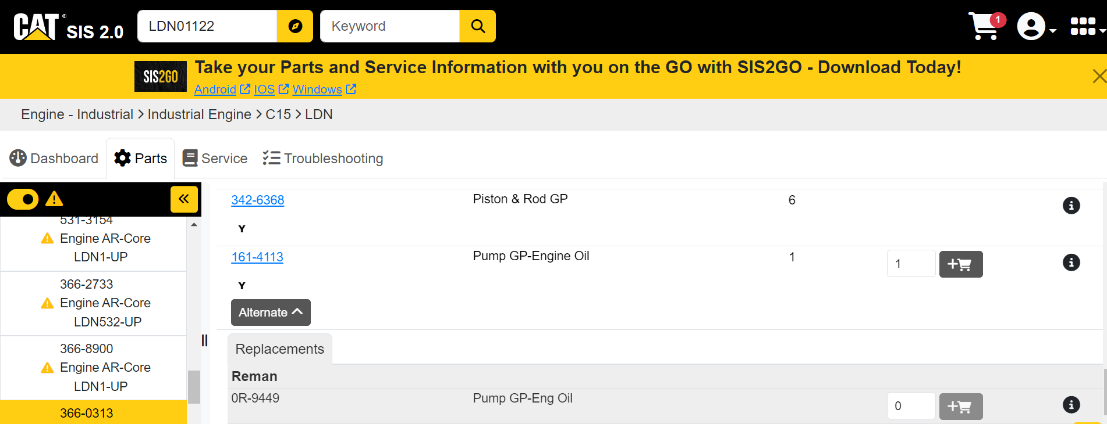
OIL PUMP INDENTIFICATION

Slide 17
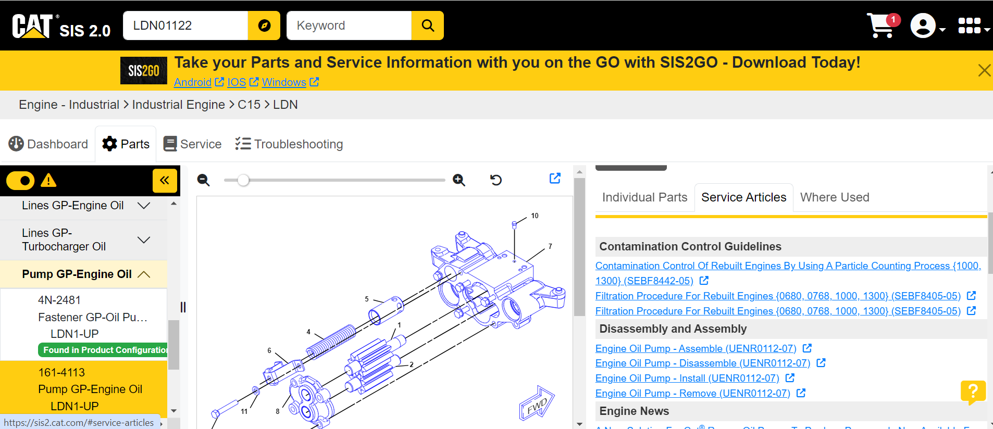
SERVICE INFORMATION/ARTICLES

Slide 18
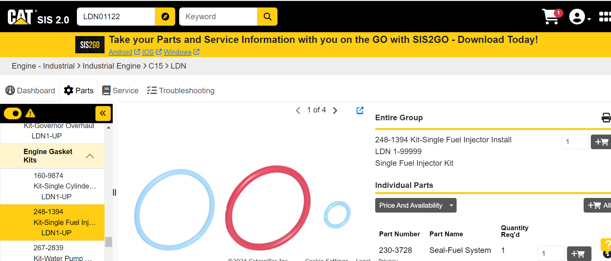
REPAIR KITS/GASKET KITS

Slide 19
SCHEMATIC

Slide 20
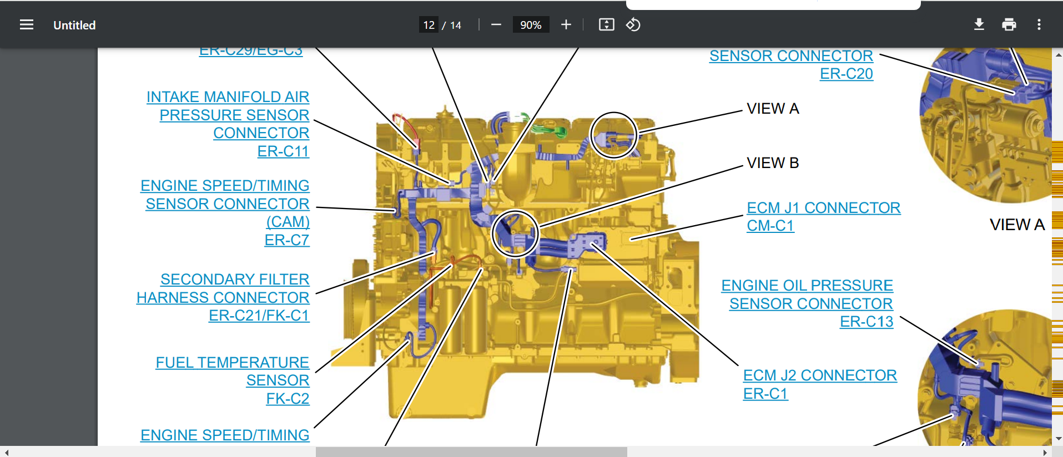
FUEL TEMP. SENSOR

Slide 21
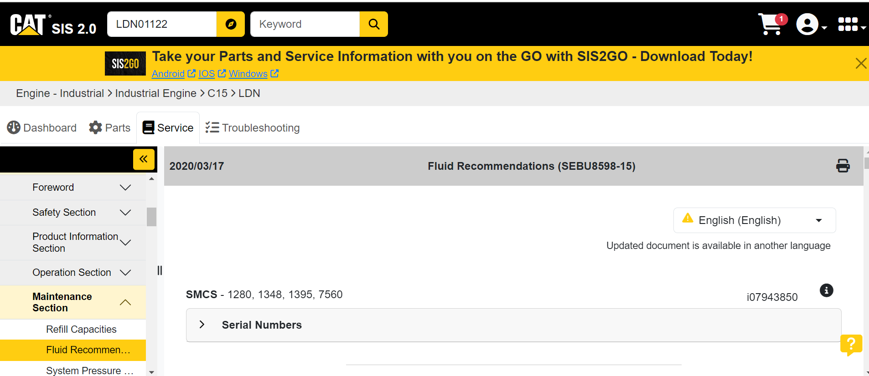
MAINTENANCE SECTION

Slide 22
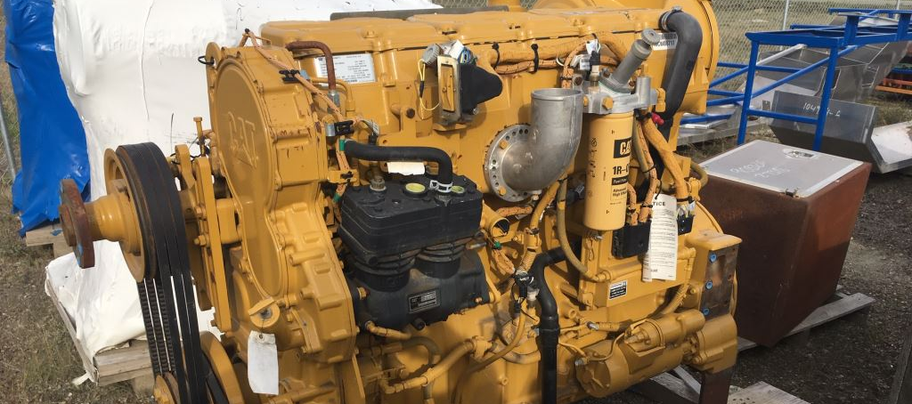
QUESTIONS?

