Slide 1
ISD Dealer Days
Presenter Name: Bruce A. Berry
Topic: Technical Support and Service Letters

Slide 2
Bruce A. Berry – based out of MiltonCat in Scarborough Maine
ISD Program Manager – covering ME, NH, MA., RI.
Technical Communicator covering ME.,NH, MA., RI, VT, NY

Slide 3
Contact information
Cell: 207-229-4964
Office: 207-885-8014
Home: 207-282-5021
Helpdesk ( factory) 800-447-4986

Slide 4
Email: bruce_berry@miltoncat.com
Have used texting with field service technicians to review photos, screen shots, generating factory passwords, injector files, Flash files

Slide 5
Cat Electronic Technician ( ET )
1st ET License is included with your annual ISD subscription ( $975.00 )
Additional ET licenses are available at $250.00 per license, per year
ET Software found at: https://catdealer.com/catet
Requires Activation code: service_solutionscenter@miltoncat.com
Ask for the industrial engine subscription: NEXG5046
Ask for an ET transfer if laptop fails and needs to be replaced ( no charge)
Cat Communication Adapter 3 is preferred for all new Cat engines
Not connecting: contact SSC first, myself / Chris Cipperley for possible onsite troubleshooting.

Slide 6
Service Letters
PSPs are programs providing dealers and customers support for known product problems. The two types of PSPs
Before or After Failure PSPs
After Failure Only PSPs

Slide 7
Service Letters
After Failure Only PSPs allow dealers to only perform the PSP repair once a failure has occurred
Before or After Failure PSPs allow dealers to perform the repair prior to a failure or at the time a failure occurs. Completion of before failure repairs is based on the repairing dealer assessment.

Slide 8
Service Letters
Priority PIPs are programs established to eliminate future potentially costly repairs and/or meet regulatory requirements.
A Priority PIP has a Completion Date and a Termination Date

Slide 9
Service Letters
PIPs are mandatory programs issued to repair or replace parts or assembled components. The three types of PIPs
include:
Safety PIPs – safety Hazard, immediate attention
Priority PIPs – proactive action to prevent future failure
Parts Stock – return the improper part to Miltoncat

Slide 10
Dealer Expense Reimbursement
Caterpillar participation in PSPs may be 100% of allowable expenses as outlined in the Service Letter based on age/hours; or may be prorated to a lower Caterpillar participation. The percentage of Caterpillar participation in the “Service Claims Allowance” section applies to all parts and labor allowed.
Just because the standard warranty has expired doesn’t mean the engine can’t qualify to meet the age / hour limitations of a Service Letter.

Slide 11
Resultant Damage
Additional Cat® parts and labor required to repair resultant damage after a failure are reimbursable under the Service Letter if justified in the claim story.

Slide 12
Where to Find Service Letters ( HTTPS:SIMS.CAT.COM )

Slide 13
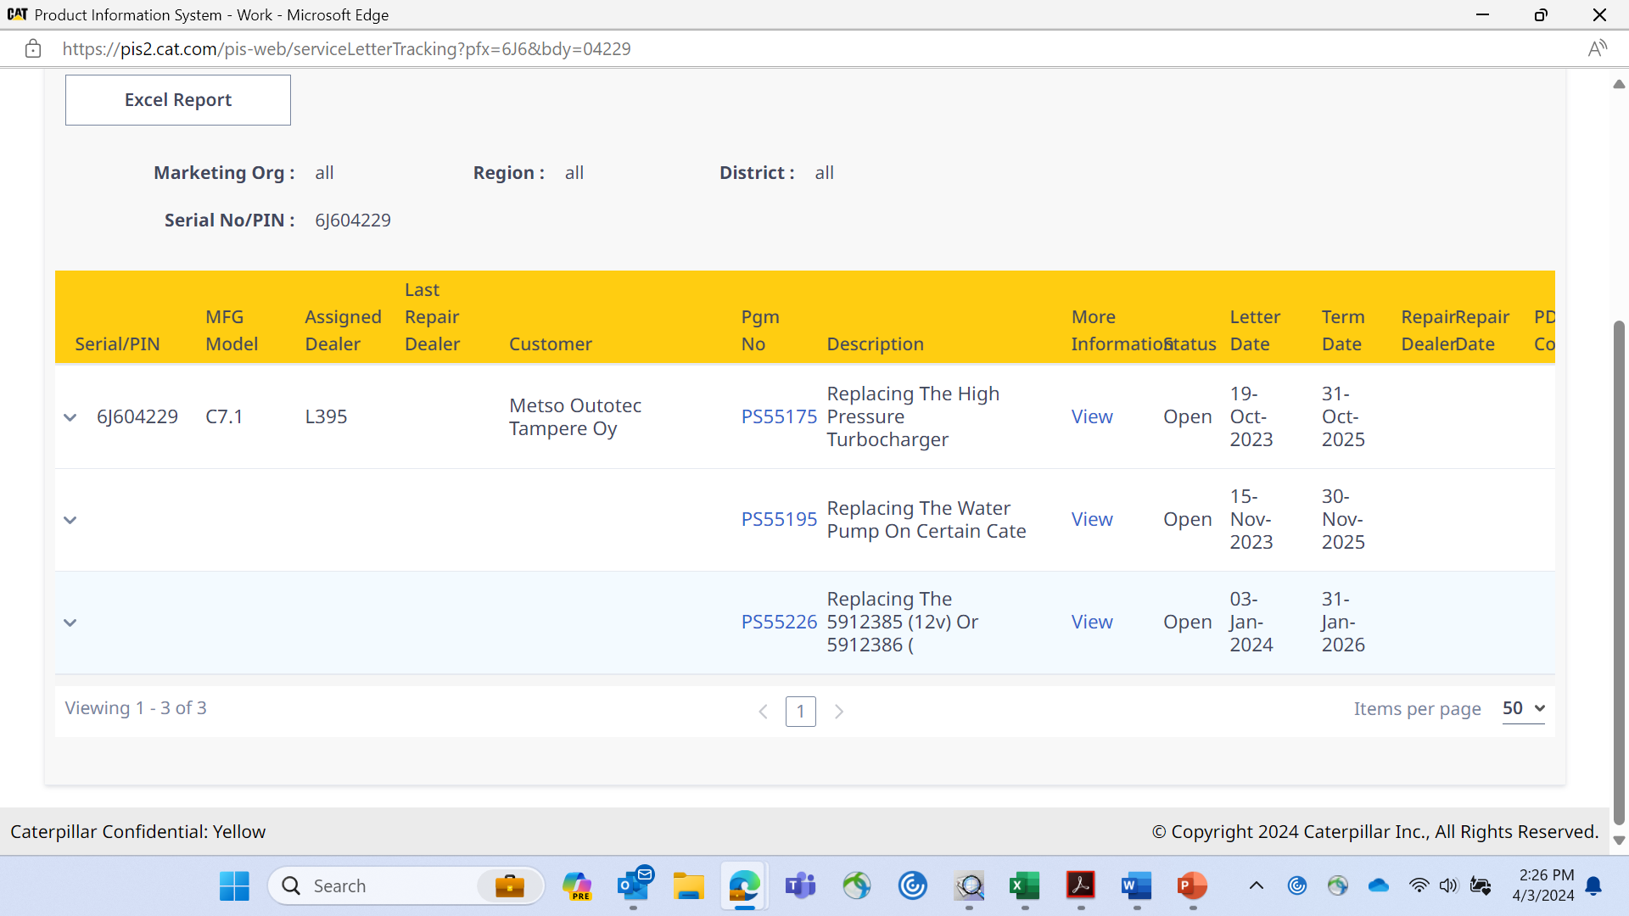
Service Letter Example

Slide 14
Service Letter Example

Slide 15
QUESTIONS

