Slide 1
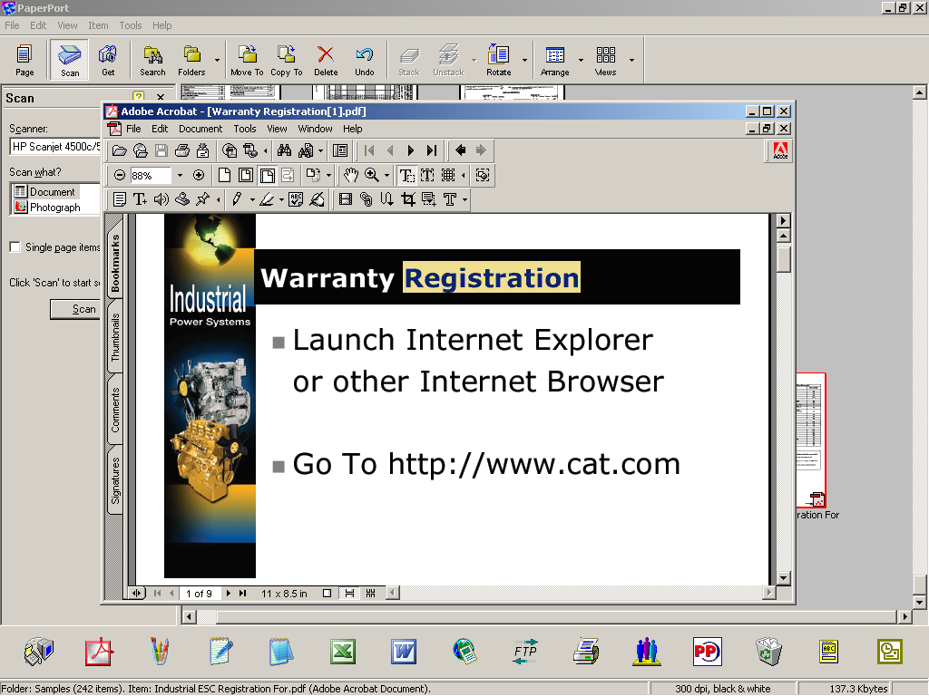
Milton Cat Welcomes you
Our Industrial Partner Dealers
ISD Warranty ESC and Marketing Training 2023
Instructor: Rhonda Gelinas

Slide 2

2023 ISD Training
Warranty ESC and Marketing

Slide 3
Safety First
Emergency Exits
Call 911
First responders
Guest Net Info:
Username: milguest179@miltoncat.com
pw: 3qTeqzmh

Slide 4
ISD Agenda
8:30 – 4:30
Day 1 and Day 2
10:00 – 10:15
Break 10:00 – 10:15
12:00 – 1:00
Lunch 12:00 – 1:00
2:30 PM – 2:45 PM
Break 2:30 – 2:45
4:30 PM
Departure

Slide 5
Complete the Pre-Test

Slide 6
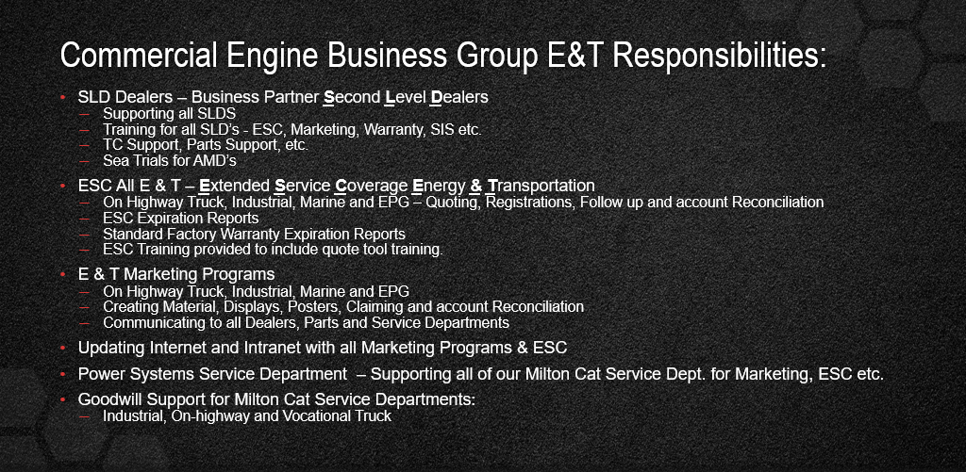
Commercial Engine Business Overview Some of What We Do:

Slide 7
Who are our Business Partners
  ISD Dealers – Industrial Service Dealers
    11 Dealers Total
    1 Maintenance
    10 Full Service – Level 2
  TEPS Dealers – Truck Engines Parts and Service currently supporting:
    72 Full Service Dealers
    29 Authorized Part Dealers
    1 Mega Parts
    AMD Dealers – Authorized Marine Dealers
    13 Dealers Total
  TIA - Truck Independent Account
    10 Dealers signed up with many more to follow
  50% of all Parts Sales go through Independents so we must pull from those key decision makers

Slide 8
What is an ISD - Industrial Service Dealer
An independently-owned service outlet that provides industrial end users with complementary Product Support services for their Cat Industrial engines
ISD’S are administered by the Cat Dealer and delivers the Cat Brand Promise!

Slide 9
ISD Program Content
The ISD supports the Cat Dealer in being able to offer complementary product support coverage for end-users in various Caterpillar industrial engine-powered market segments. This product support can be provided through OEM-affiliated, product application-oriented, ISDs with the overall objectives of:
  increased end-user satisfaction through faster, local, service response and delivering lower operating cost solutions
  incremental Cat parts sales POPS for primarily maintenance related parts
  overall customer preference for Caterpillar-powered products and services

Slide 10
ISD Program Content
The Service Information System SIS and Caterpillar Technician (Cat ET) are major elements of the annual subscription.
Multiple industry dealers (single dealer code, covering more than one industry) will receive the complete (truck and commercial) SIS Library. Access to secure information is controlled by CWS account and password as established by Caterpillar dealer program manager
SIS2.0 – Accessed using single CWS Logon ID and password for each user. This allows a number of users at a single site to access SIS information at the same time.

Slide 11
ISD provides benefits to our customer
Convenient : “Cat factory-backed” parts & service availability
Provides Cat Value-added solutions
Leverages Industrial customer knowledge/focus and local relationships
Improved total coverage = improved customer satisfaction

Slide 12
Objectives…….
Understand where to obtain warranty information
Understand proper procedures to follow for a warranty repair
Decrease Wasted Shop Time and Increase Warranty Recovery and Profitability
Notes:
This training course focuses more on what is, and what is not warranty and the proper procedures to follow in order to have a successful repair. A lot of time is wasted in troubleshooting a failure, this is where three very useful elements come in. Applied Failure Analysis is the first element, knowing the “ROOT” cause of the failure and therefore knowing if you have a “Defect in Material or Workmanship.” The second element is knowing how or where to find troubleshooting procedures for the complaint the customer has presented to you. The third element is knowing when assistance from Caterpillar is needed. The 2-4 Rule as presented in Warranty Update #0415 will help in decreasing wasted time in investigating problem and increase warranty recovery dollars.

Slide 13
ISD Requirements
Service Capability through Technician Training
Cat engine Tooling
Initial and on-going Cat Parts inventory
Agreements
Cat Brand Identity
Warranty support and claiming
Parts marketing
Meeting Overall performance

Slide 14
ENGINE PARTS & SERVICE AGREEMENT
2 levels of dealers
  Level 1 - Maintenance Service
  Level 2 - Full Service
  By Agreement with a Caterpillar distributor, ISD dealers can only provide warranty service on authorized engine models

Slide 15
At a Glance
ISD Offerings | Full Service | Basic Maintenance
Qualified Service, Core & Warranty Techs | X | X
Specialized Tooling | X | Optional
Parts Stocking | X | Optional
Signage | X | Optional
Training | X | X
Marketing of Cat parts | X | X
Access to PCC | X | X
Access to SIS web | X | X
Electronic Technician (ET) | X | Highly recommended
Technical Consulting Support | X | X

Slide 16
Service Level definition
Level 1 Maintenance Service
  The ability to change oil, filters, belts, coolant and perform other basic maintenance as required by Cat Maintenance guide, perform warranty and do minor repairs and replacement of peripheral components and rotating electrics and water pump with standard tooling as well as marketing selected Cat parts over a parts counter. (approximately 80% of ISDs assumed at this level) Level 1 ISDs are not authorized to perform fuel system, engine electronic repairs or engine after treatment repairs.

Slide 17
Service Level definition
  Level 2 – Full Service (Authorized to perform complete engine repair and overhaul service and warranty work as specified in the Service Warranty Guide) with specialized tooling as well as marketing a larger selection of Cat parts over a parts counter.

Slide 18
Basic Maintenance Dealer Requirements
Qualified Service Technicians/Basic Maintenance
Qualified Reman Core Inspector and qualified Warranty technician
Annual Subscription
Tooling
Parts Stocking
Signage

Slide 19
Full Service Dealer Requirements
Qualified Service Technicians/Basic Maintenance
Qualified Reman Core Inspector and qualified Warranty technician
Annual Subscription
Tooling
Parts Stocking
Signage

Slide 20
Helpful Links
ISD Program Content:
  https://engines.cat.com/en/industrial/isd-program.html
Warranty training is available on the following web site:
  https://dlms.logicbay.com/dlms/perfCtr/campus/frameset/frameset.jsp?campusId=6&switchCampus=true&LoginChoice=0
SIS Web:
  SIS 2.0 (cat.com)
  Cat Reman Guide and cross reference inquiry:
  https://dealer.cat.com/en/ps/parts/reman.html
SMCS Code
  https://smi.cat.com/smiweb/login.do
  Milton Cat ISD Link
  ISDs: Industrial Service Dealers for Heavy Equipment and Power Systems | Milton CAT

Slide 21
Definition of a Warranty Repair
How is Warranty defined?
The Caterpillar Warranty is Caterpillar's legal commitment to provide, through its dealers, customer protection for product/part defects in material and workmanship during a specified period of time or product usage. Warranty also protects Caterpillar and its dealers from unreasonable customer claims.
Caterpillar Warranty has legally binding commitments and limitations that cannot be altered. These are outlined on a legal document that is given to the customer.
What qualifies as a Warranty Repair?
A warranty repair restores the product to its operating condition just prior to the failure, by repairing and/or replacing the defective part, and the resultant damaged Caterpillar parts, gaskets, seals, etc. needed to correct the defect. A warranty repair is not intended to restore the product to a like-new condition.

Slide 22
What is Warranty
Caterpillar Warranty is customer protection for product/part defects in material and workmanship during the stated warranty period.
Warranty also serves to protect Caterpillar and dealers from unreasonable claims
Warranty is Black and White
Caterpillar District Support covers
all Gray Areas (Goodwill)
.
.

Slide 23
ISD Warranty Capability
All ISDs are authorized and supported to process parts warranty and perform warranty service repairs related to the scope of work defined above as a convenience service to the end-user. The ISDs are to be authorized to perform and claim for standard warranty, Product Improvement Program and Product Support Program repairs and potentially, special one-time-only authorized repairs beyond their normal approved scope, with the expressed pre-approval and support of the local Cat dealer.

Slide 24
Determining Type of Warranty
Warranty
Standard Warranty
Standard Extended Warranty – what is this?
Parts Warranty
Emission Warranty
Insurance Coverage
Extended Service Coverage (ESC)
Extended Service Overhaul Protection
Used Engine Advantage Program
Principle Work Codes
Determines Coverage Type

Slide 25
Warranty Situations
Determine “Root” Cause of Failure
Caterpillar Warranty is Responsible for Failures of Caterpillar Material or Workmanship

Slide 26
Non - Warranty Situations
These situations are not for Caterpillar Warranty:
Dealer Workmanship
Incorrect Parts Consist (errors or shortages)
Preventative Repairs
Goodwill

Slide 27
Determining Type of Warranty/Extended Service Plan
In an emergency situation, when the Cat distributor is not available, please call the Caterpillar Call Center.
Phone : 1-800-447-4986

Slide 28
WARRANTY STATEMENTS
NEW ENGINE WARRANTY
REMANUFACTURED ENGINE WARRANTY
PARTS WARRANTY
EMISSIONS WARRANTY
Notes:
go to overheads and show warranty statements

Slide 29
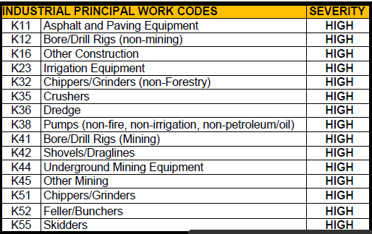
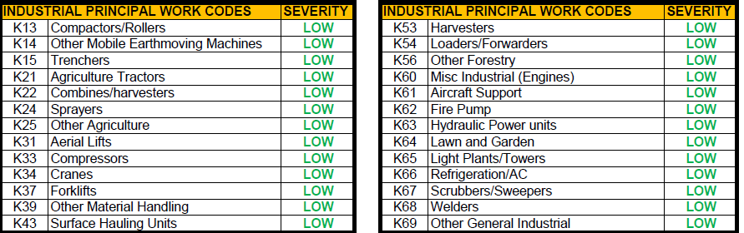
Industrial Application Principal Work Codes

Slide 30
WARRANTY COVERAGE
SIMSi
PW Code
Delivery Dates

Slide 31
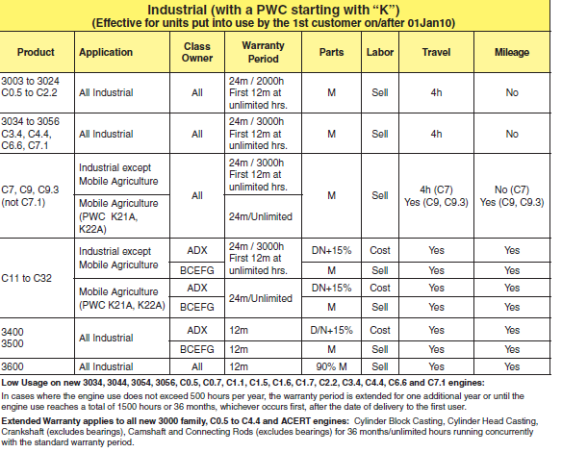
WARRANTY COVERAGE

Slide 32
Additional Standard Warranty Information
Travel Time and Mileage
3000 & C0.5 thru C7
Up to 4 hours if in the opinion of Caterpillar, the product cannot reasonably be transported to an authorized dealer.
C9, C11, C13, C15, C18, C27 and C32 engines
Provide reasonable travel expenses for authorized mechanics, including meals, mileage and lodging when Caterpillar elects to make the repair on-site

Slide 33
Parts Warranty
New and Remanufactured parts or assembled components 12 month Parts Warranty
New and Remanufactured parts or assembled components used in gas compression applications – 12 month Parts Warranty
Does ESC Have Parts Warranty?

Slide 34
Travel Expense
For 3056 and C7 marine Propulsion Engines and C1.5 and C2.2 marine generator sets if applicable, travel is reimbursable up to 6 hours maximum per work order. Reasonable mileage is also claimable.
For all other product during the standard or extended warranty period, if applicable:
  Provide reasonable travel expenses for authorized mechanics, including meals, mileage and lodging when Caterpillar chooses to make the repair on site.
Note: Travel mileage expenses will be reimbursed for the distance from the nearest Dealer branch store to the job site authorized to perform repair service to that particular product. Reasonable travel and mileage is figured at an average rate of 40 mph. Excess travel and mileage due to scheduling issues, acts of mother nature, traffic congestion issues in densely populated areas or extremely remote locations is beyond what is considered reasonable.

Slide 35
Claimsi & Internet
Rhonda Gelinas
Product Support Manager
E&T Business Partners, ESC & Marketing

Slide 36
Course Schedule
SURF INTO:
  Global Warranty https://warranty.cat.com/training.
  Parts Return Request
  SIS – Look up S/L’s for claiming purposes
  View other informational Aids available on the WEB as time permits

Slide 37
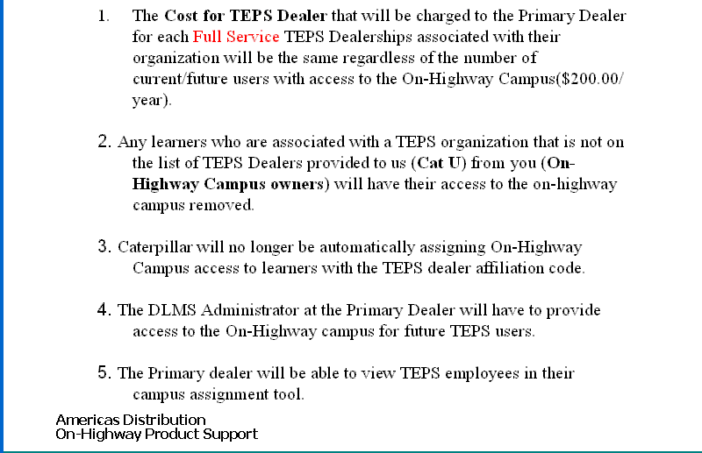
On-line Classes – Dealer Management System (DLMS) for ISD Dealers

Slide 38
Review Dealers Best Practices
Who is responsible to determine Warranty and communicate with customers
How is Part Causing failure determined
How are TRG’S identified
How are Marketing Programs administered

Slide 39
Log-in issues
Milton Cat Customer Support Center
  508-482-5700
  Or email: customersupportcenter@miltoncat.com
  Software sales and support including SIS, SISWeb, and ET purchased.

Slide 40
IS IT COVERED
VERIFY COVERAGE & DELIVERY DATE AT CAT ON WARRANTY.CAT.COM
VERIFY COMPLAINT AND COVERED COMPONENT UNDER APPLICABLE COVERAGE
REVIEW REPAIR HISTORY AND OPEN SERVICE LETTERS BEFORE WORKING ON ENGINE

Slide 41
Miscellaneous options
Problems/feedback
Favorites
What’s New

Slide 42
Milton Cat Web Site
ISD
http://www.miltoncat.com/engines/industrial-power-systems/engine-service-dealers
Username: MiltonCATISD
Password: NA
Lets go to the site:

Slide 43
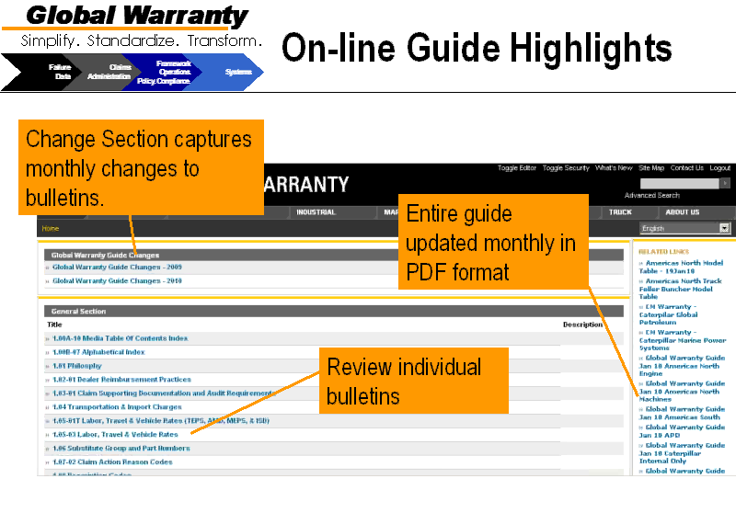
On-line Guide Highlights
It is very important to check often!!

Slide 44
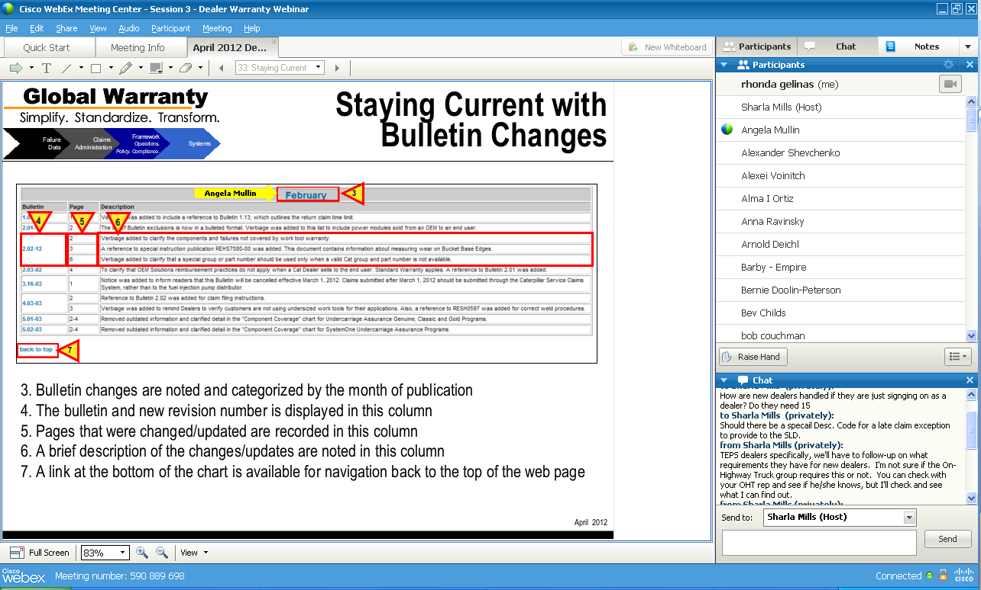
Staying Current with Bulletin Changes

Slide 45
Repair History by Serial Number (SIMSi)
SIMSI
Customer Name and Address
Search for Open PIP/PSP’s
Warranty Coverage
Sales and Service by Serial Number

Slide 46
SALES AND SERVICE BY SERIAL NUMBER (REPAIR HISTORY
Why sales and service?
What information can be obtained from this link?

Slide 47
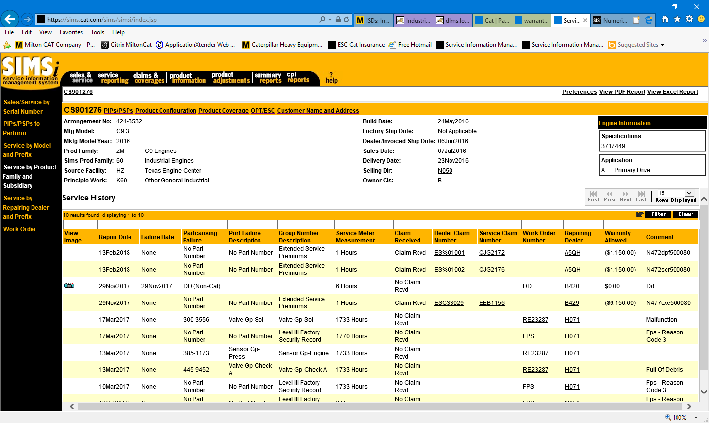
Sales and Service By S/N: Use available links listed for additional information
There are 23 columns of information available to view. The choices are selected under Preferences. Information that is underlined is a link that you can click for more detailed information.

Slide 48
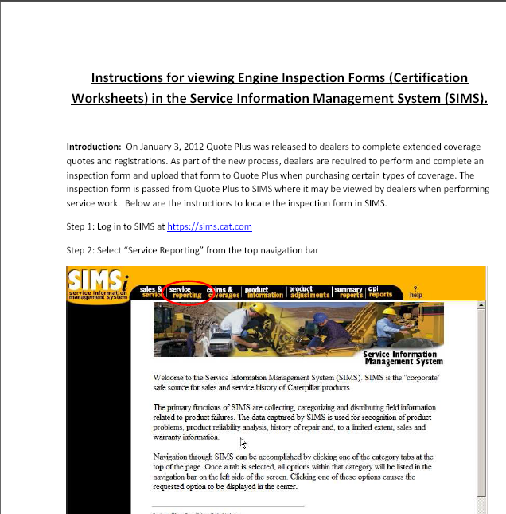

Slide 49
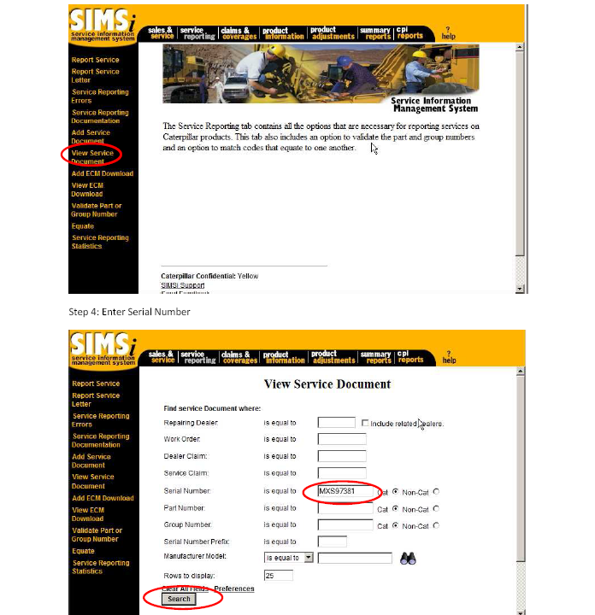

Slide 50
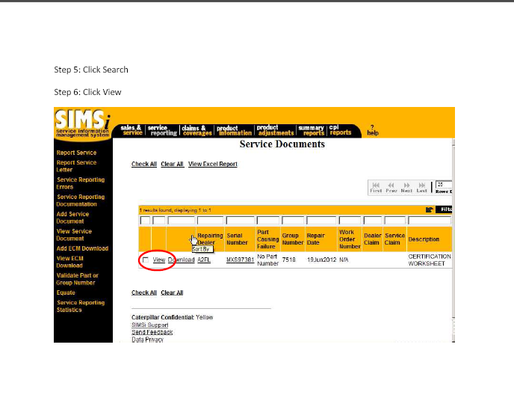

Slide 51
How do I look up S/L’s on engine that has S/L showing from PIS Screen?
See sample in next slide – simply click the Service Letter Link and this will bring you into SIS Web direct to Service Letter.

Slide 52
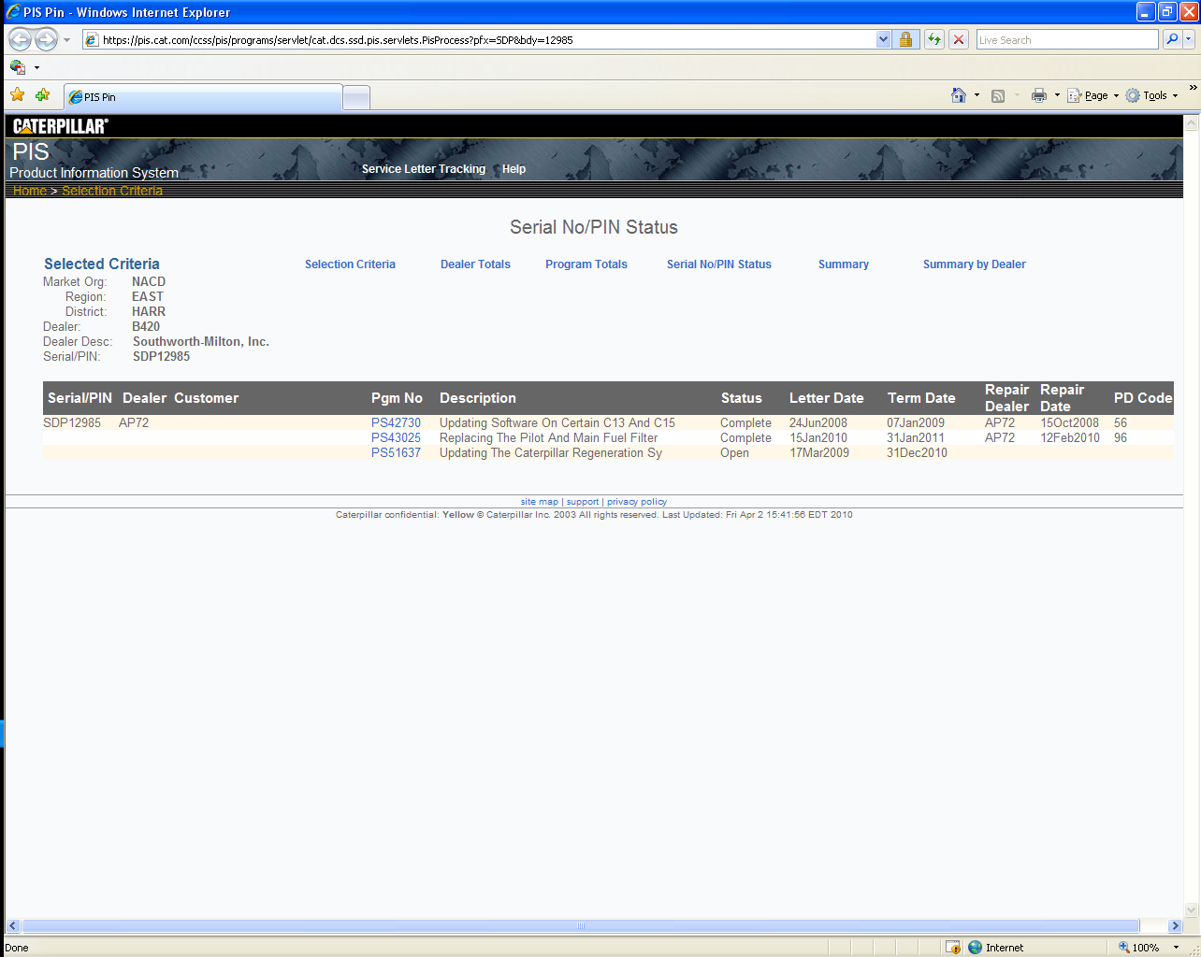
Use link to get to the applicable S/L. Are Pop up blockers off?

Slide 53
PCC
Chris Cipperley

Slide 54
CLAIMSI submitting claims

Slide 55
Claimsi FAQ’s
FAQ’S – Frequently asked questions
By clicking on FAQ’s at the top, you can see what questions are most often asked by our users and the answers
If you have questions or problems, the answers could be just a click away!
Review FAQ’s

Slide 56
HELP
IF YOU DON’T SEE YOUR ANSWER IN FAQ’s, ADDITIONAL INFORMATION IS AVAILABLE FROM THE HELP TAB

Slide 57
What’s New in Claimsi Maintenance & Dealer Index?
Component - SMU
Component SMU Usage Field
In the SMU Field, enter the elapsed Hours/Miles/KM on the component for the part causing failure since it was last installed. If the component serial number is not available, leave this field blank.
In the usage code field, a measurement from the drop down arrow for the component causing failure. Valid values for the field are as follows:
H = Hours
M = Miles
K = KM
  leave this field blank.

Slide 58
What’s New in Claimsi Maintenance & Dealer Index?
Durability Indicator
Component Serial Number
The durability indicator field indicates that a “durability event” has taken place. The information in this field should match the corresponding SIMSi record for repair. For additional information on determining a durability event, visit: https://dealer.cat.com/quality
Click What’s New to see all updates
This field is used to capture component s/n’s for the part causing failure. Per Warranty bulletin 2.01 & 4.01 this information is required information for hydraulic pumps, motors and control valves.

Slide 59
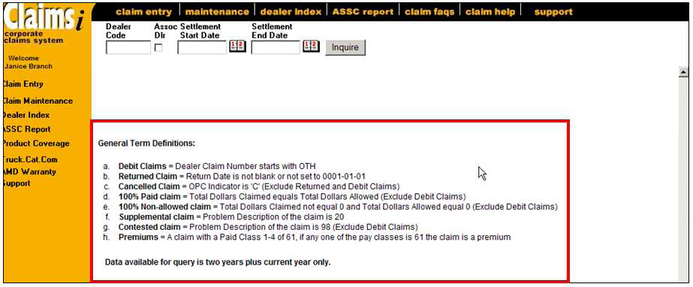
ASSC REPORT
As shown in the illustration below, the last section of the “ASSC Report” is a listing of “General Term Definitions.”

Slide 60
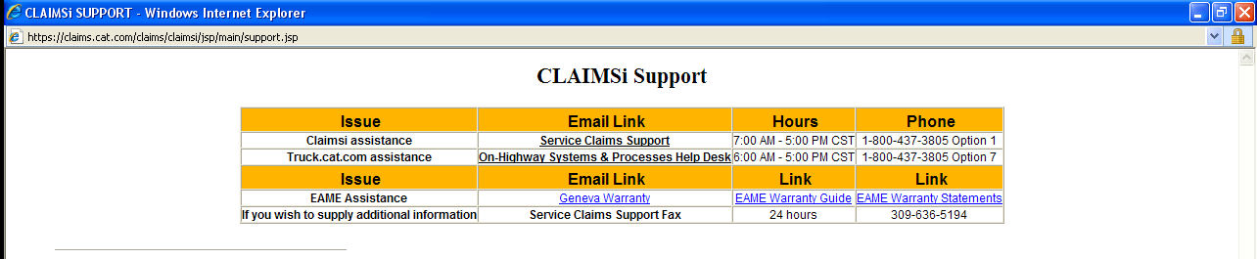
CLAIMSI SUPPORT

Slide 61
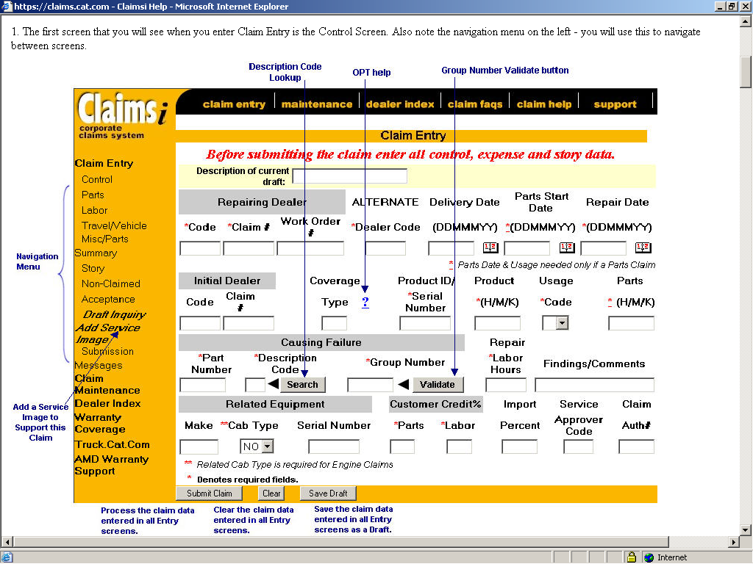
Claim Entry: Control Screen

Slide 62
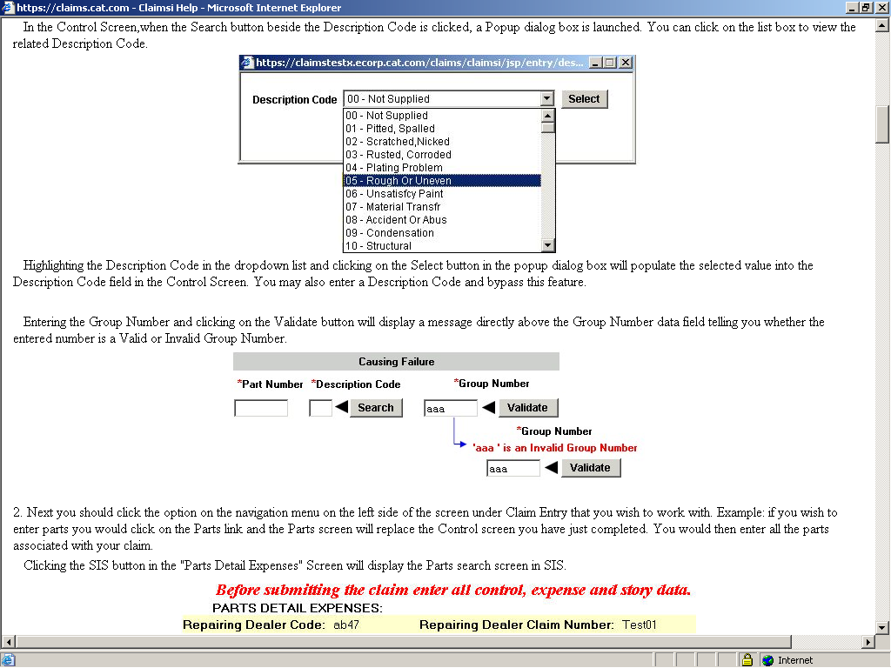
Claim Entry:

Slide 63
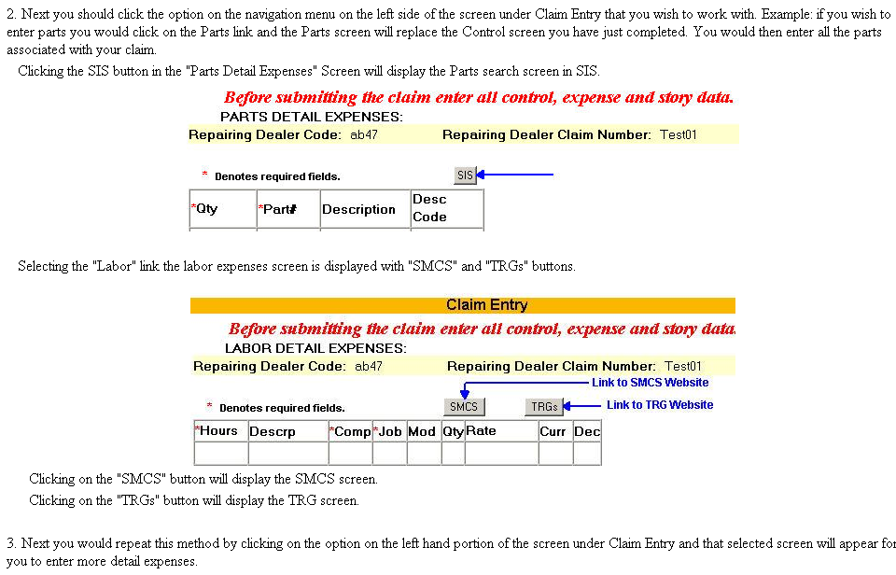
Claim Entry:

Slide 64
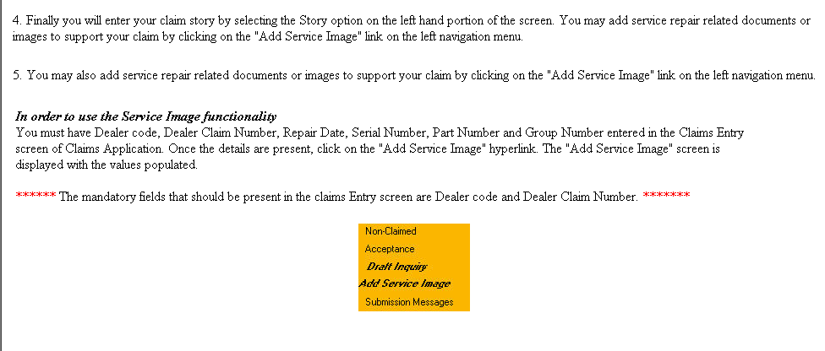
Claim Entry:

Slide 65
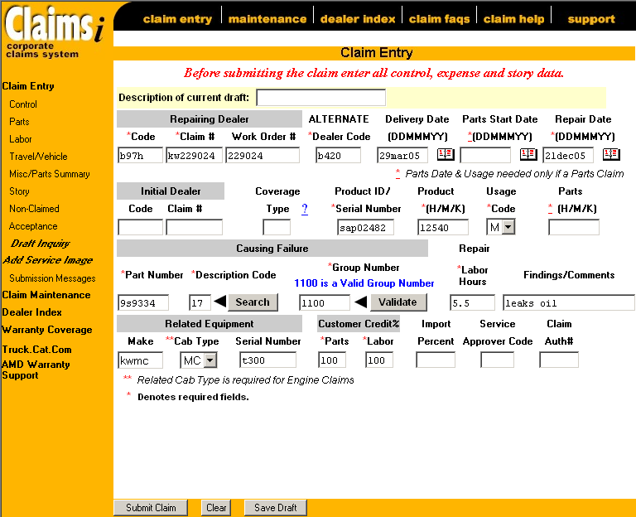
Claim Entry:
If the part causing failure is not in the group # listed, will you be able to continue?

Slide 66
Goodwill Claims
Goodwill Authorization sheets will be sent via email
The sheet is an Excel format with many different worksheets within the workbook
Click onto the Claim Story Draft at the top of the page. Copy and paste into the story

Slide 67
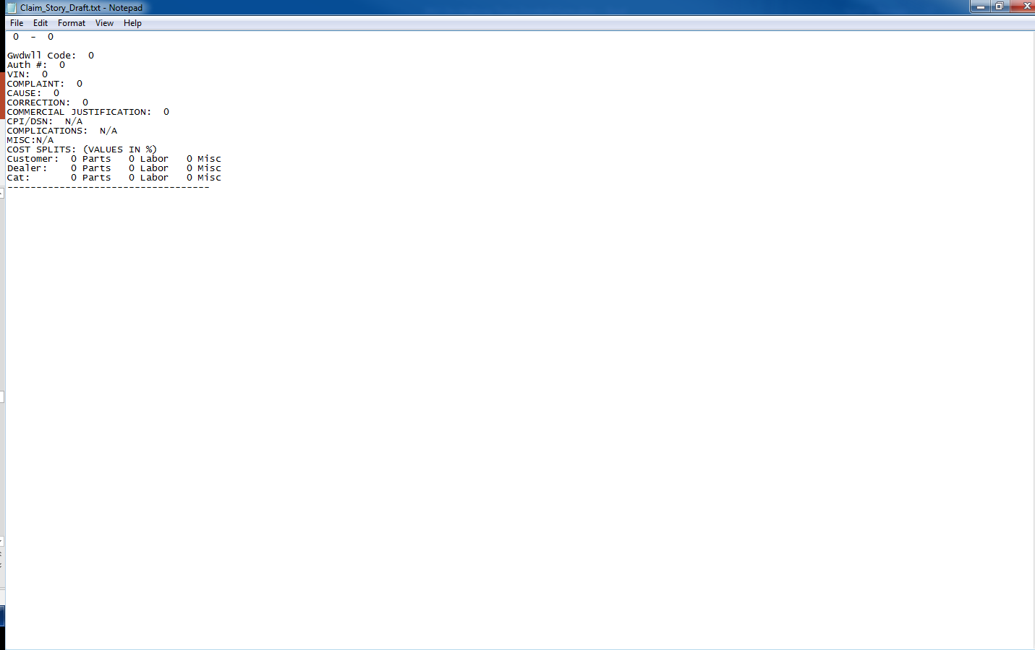
Goodwill Form

Slide 68
Draft Claim
HIT DRAFT FREQUENTLY FROM ANY OF THE LOCATIONS OF THE ENTRY SCREENS
CREATE DIFFERENT CLAIM TYPES FOR TEMPLATES
SAVE AS DRAFT WHEN UNABLE TO COMPLETE AT THIS TIME

Slide 69
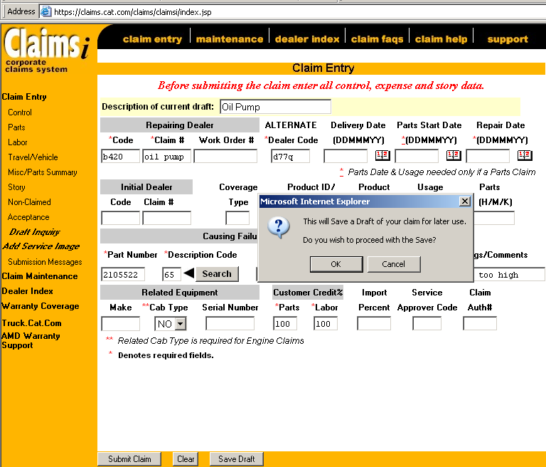
Save Draft
Do I have to be in the control screen to save this as a draft?
Save draft can be done from any stage of the claim entry process. See save draft button at the bottom of each screen

Slide 70
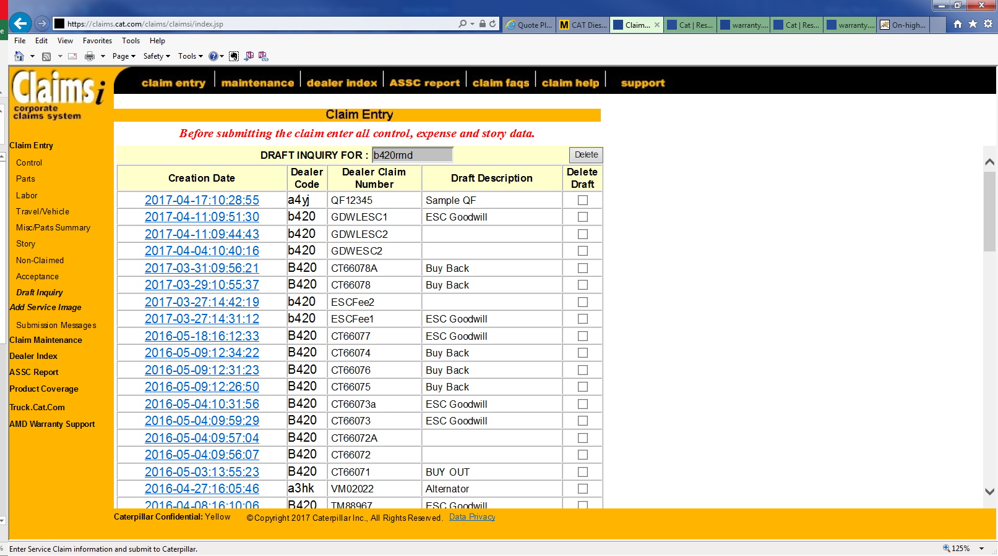
Different Draft Claims
To save a draft claim the minimum field requirement from the control screen is to fill in Claim # and Dealer Code.

Slide 71
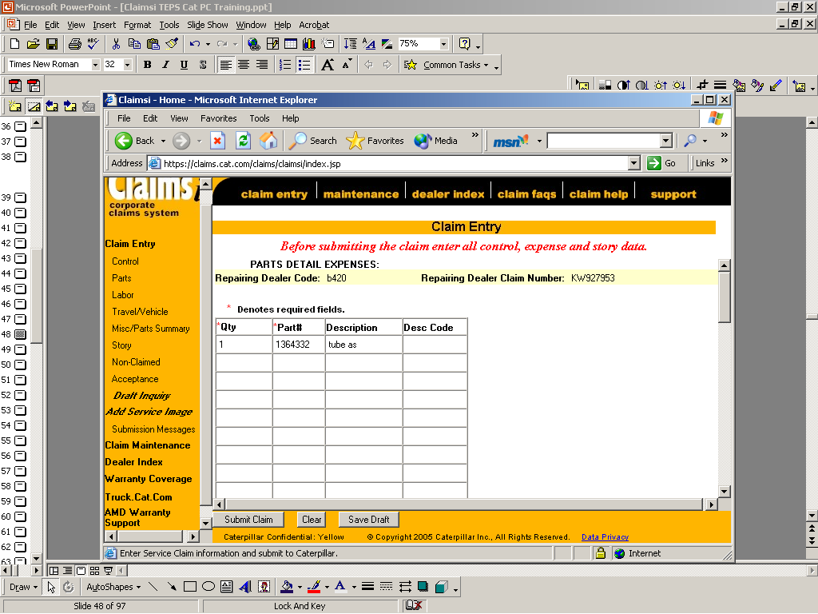
Parts Detail
Do I save each page before going onto next link or page?
A. This is an optional function
The description is not filled in until the claim is submitted. You can
Add your own however will be overridden by system description.
You would view the description from the maintenance screen.
Correct details if claim amount discrepancy, good place to start.

Slide 72
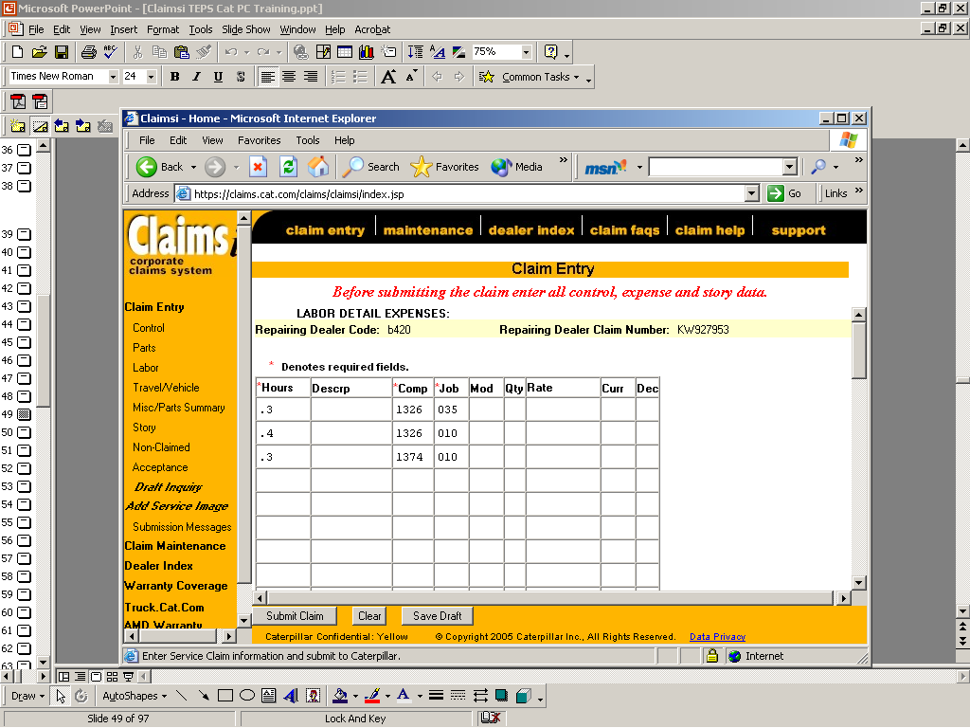
Labor Detail
The Labor Rate will be filled in by the system once claim is submitted
To review the rate, this will be completed from maintenance screen.
You should not enter Qty or Curr unless different than US dollars or
Dec unless you have been instructed specifically for your claim.
See SMCS Code section in book provided or go to truck.cat.com smcs.

Slide 73
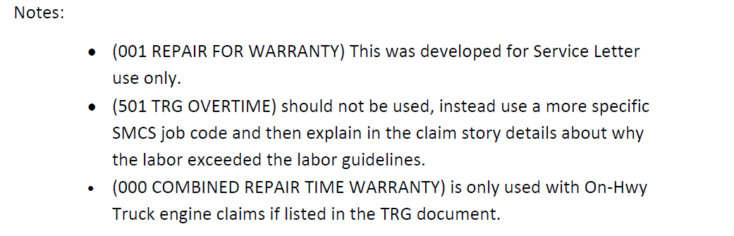
TRG SMC Job Code

Slide 74
Travel Vehicle Detail
Travel Rate
When applicable to the product being serviced, the Travel Rate is used to compensate the Dealer for the Service Technician’s time spent traveling to and from a job site to perform a repair. It is 90% of the Posted/Advertised Customer Labor Rate. Shop supply and Disposal fees are not included in this calculation. The Travel Rate is multiplied by the hours provided in the claim detail when applicable for a warrantable repair.
Note: When claiming travel and mileage, the two items must be listed separately in the claim detail.
Vehicle (Mileage/Kilometer) Rate
When applicable to the product being serviced, the Vehicle Rate is used to compensate the Dealer for Service Truck expenses for driving to and from a job site to perform a repair. It is 1.6% for Kilometers and 2.6% for miles of the Sell Labor Rate (which includes shop/disposal allowances). The Vehicle Rate is multiplied by the
miles/kilometers provided in the claim detail when applicable for a warrantable repair.
Note: When claiming travel and mileage, the two items must be listed separately in the claim detail.

Slide 75
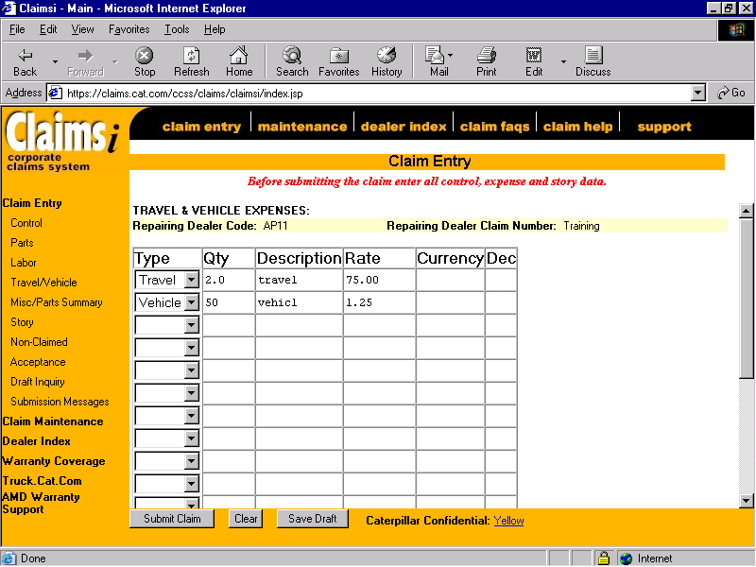
Travel Vehicle Detail
Using
the
Drop
Down,
Select the
Entry
Type.
QTY should be the hours traveled to the nearest tenth of
an hour. Description and Rate are optional fields again and
Can be viewed/printed from Maintenance Screen.

Slide 76
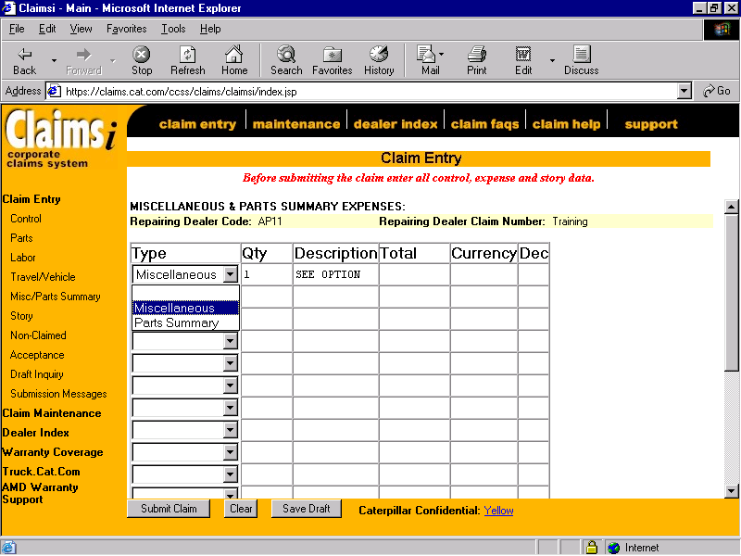
Misc/Parts Summary
See Training Web Page and
Job for acceptable codes – also in handouts
https://warranty.cat.com/cda/files/1385989/7/Acceptable+Miscellaneous+Expense+Descriptions05.11.pdf

Slide 77
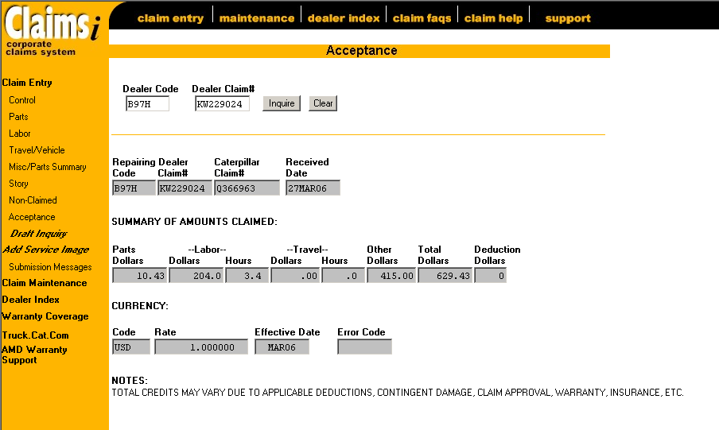
Acceptance after Submission
Summary of totals for
Information you have
Entered. This is prior
to processing at Cat.
This is initial acceptance,
and totals are
subject to change!

Slide 78
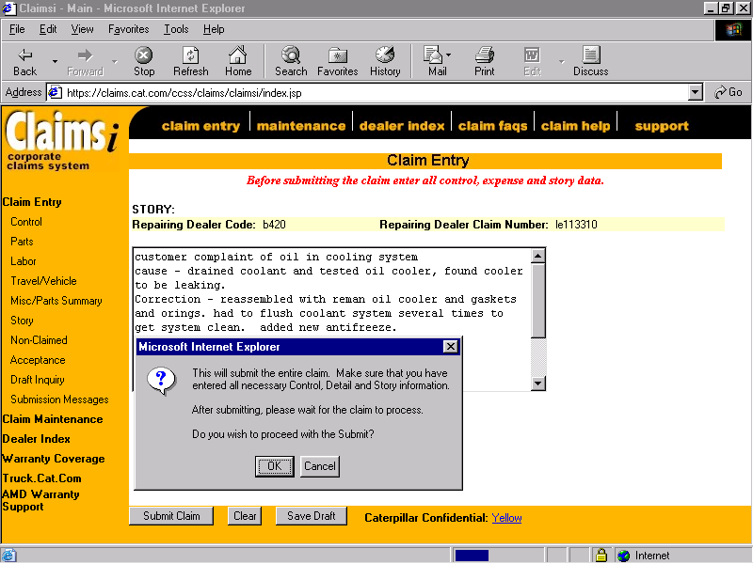
Submit Claim
If you are unsure, you can save a draft of your claim and
Review it before submitting

Slide 79
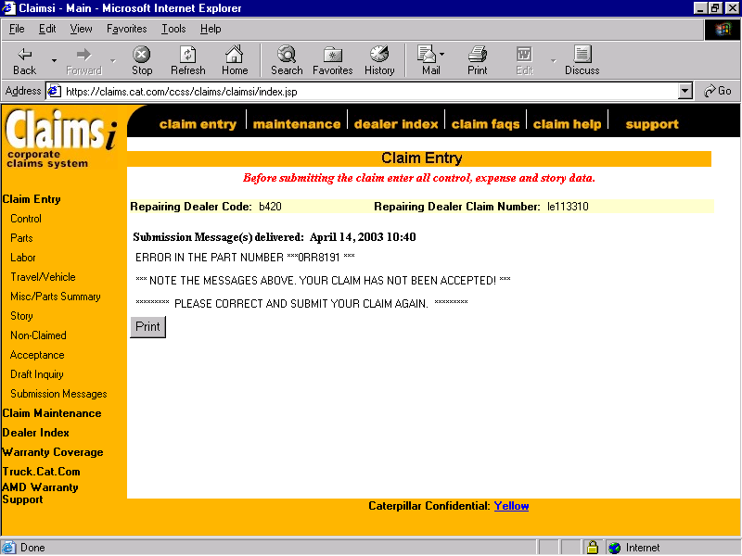
Submission Messages
From here, go the area that contains the grief and correct. Hit submit claim again once all items have been addressed.
From here simply go to the area that
Contains the grief by clicking
On the applicable link

Slide 80
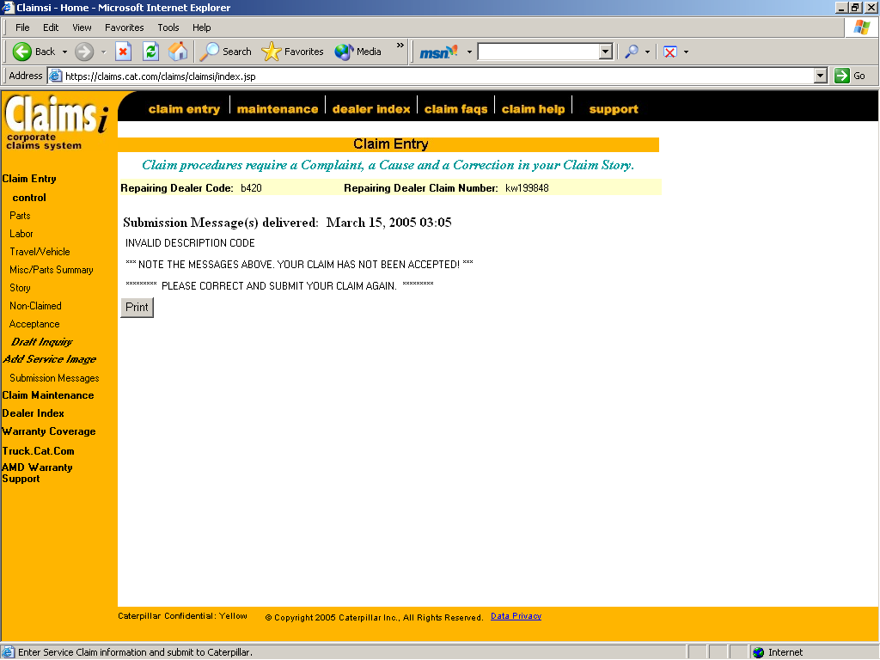
Claim Not Accepted

Slide 81
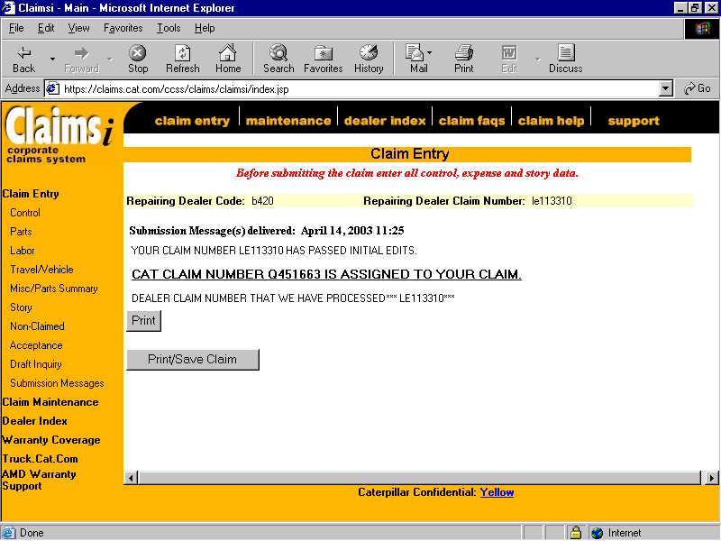
Claim Submission

Slide 82
What does print/save do?
Does it save my claim?
When selecting the print/save link you will not need
to select print link separate.
The information obtained from print/save will be
Control Screen
Parts Detail Expenses
Labor Detail Expenses
Travel & Vehicle Expenses
Miscellaneous & Parts Summary Expenses
Story
Non-claimed Expenses

Slide 83
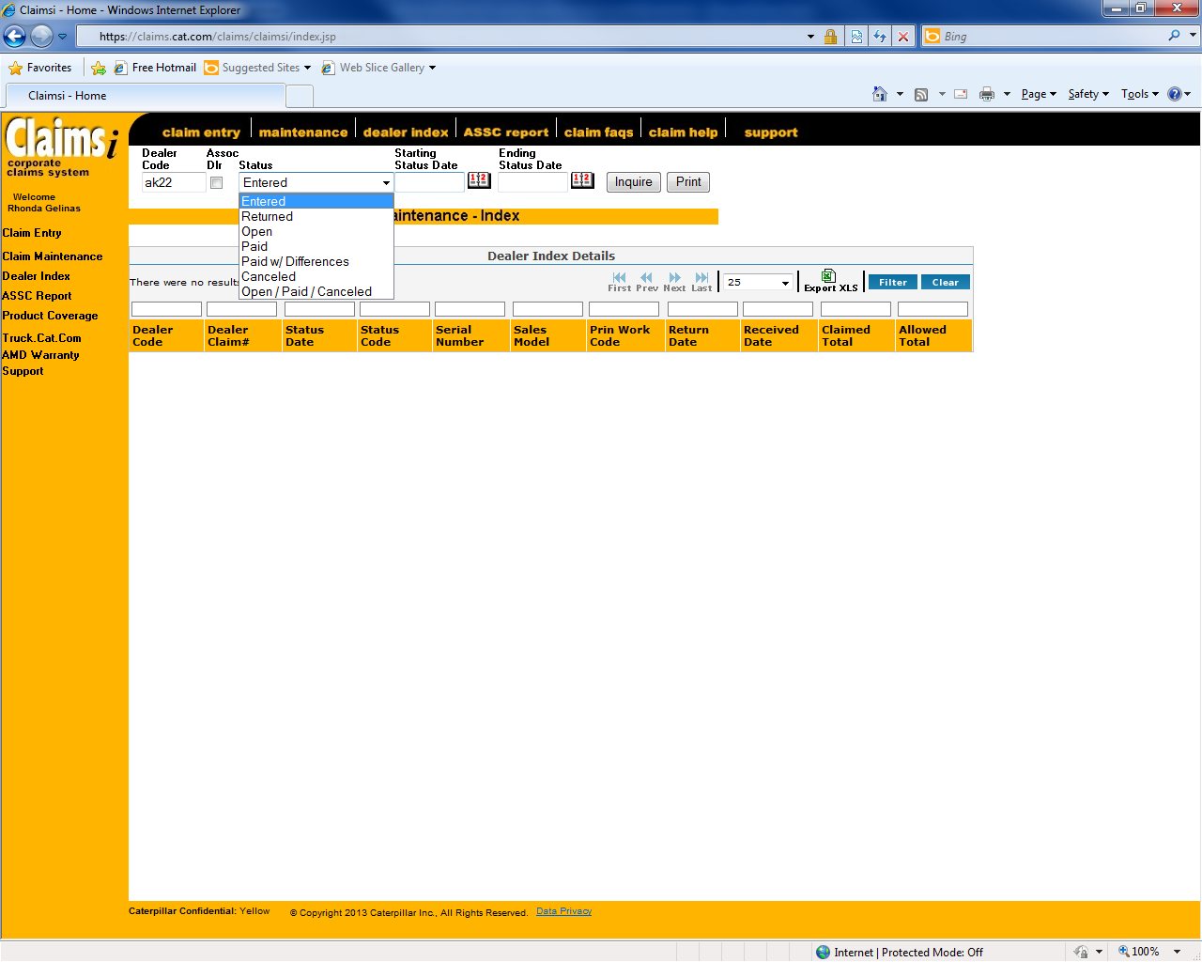
DEALER INDEX
Check status of all claim types
  Entered
  Returned
    Recently changed
  Open
  Paid
  Paid W/Differences
  Canceled
  Open/Paid/Cancelled

Slide 84
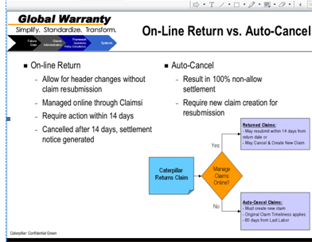
What is a Returned Claim
14 days to correct

Slide 85
Benefit of Claim Returned
Having the default now to have the claims returned to grief is more forgiving as this will allow a claim an additional 14 days when the claim is submitted on day 59 and has a header issue, that gives you the 14 days in addition to get this corrected.
Risk: Slippage in Timeliness progress
  Distraction of monitoring additional function
  Reliance on additional 14 days

Slide 86
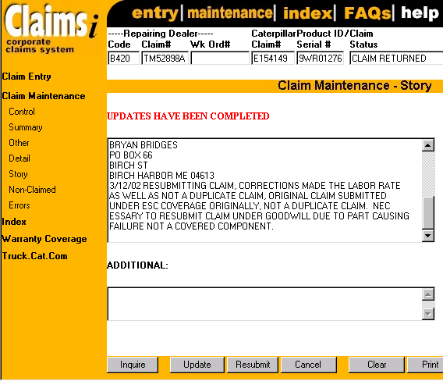
Grief Hold Update
Update story line with today’s date and should also add your name to claim in the event the analyst has a question so they know who to contact.
4.23.12 claim updated by Rhonda Gelinas

Slide 87
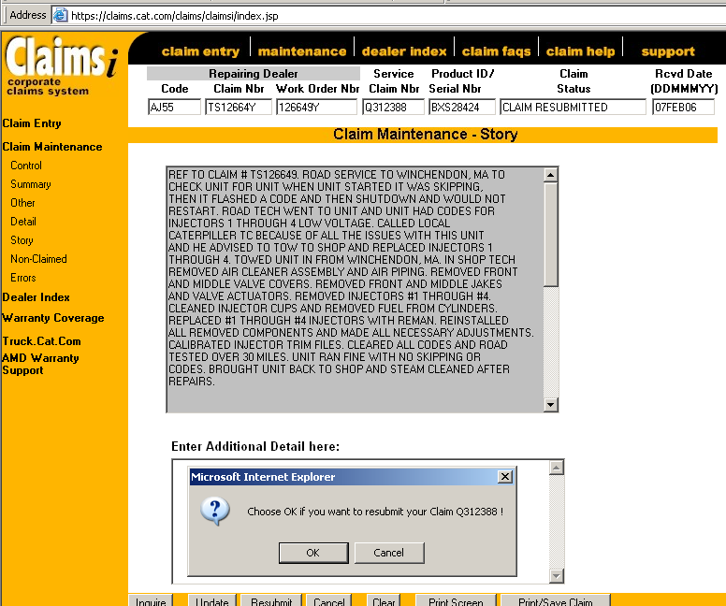
Grief Hold Update
You can resubmit the claim from any of the screens by clicking on the resubmit button. Once you do a screen will appear to allow you to accept or cancel. Once accepted you will receive a message. If hit cancel, nothing will happen.

Slide 88
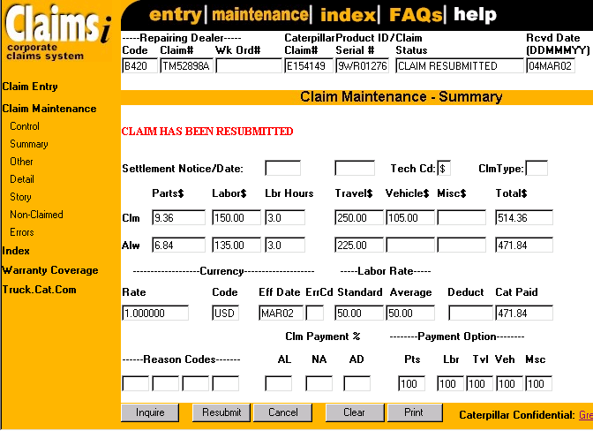
Grief Hold Update
Claim confirmed as resubmitted in red.

Slide 89
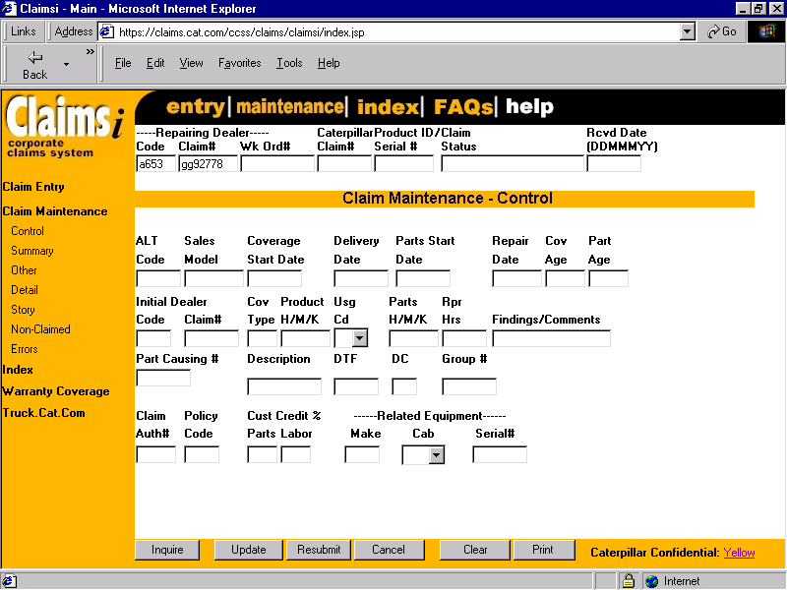
Claim Maintenance
You can edit or update items when the claim is in the
Entered or Returned status. You can not edit the Repairing
Dealer Code, Claim Number or Engine S/N. You can cancel
a claim in the Entered Status only Cat must Cancel if transmitted.

Slide 90
Emissions
Where do you find Emission Statement and hour limitation?
    Answer – Bulletin 7.01 and 7.02
  All Claims must have “97” PD Code
  First line of claim story enter “Emission Warranty”

Slide 91
Order of Coverage
Bulletin 1.11-15
Rationale for the order in which it is structured
Order of coverage affects
  The repair
  Repair invoicing
  How a claim is filed
1. Service Letters 2. Emissions 3. Standard Warranty 4. Extended Coverage 5. Parts Warranty 6. Work Tools 7. Merchandising/Assurance Programs

Slide 92
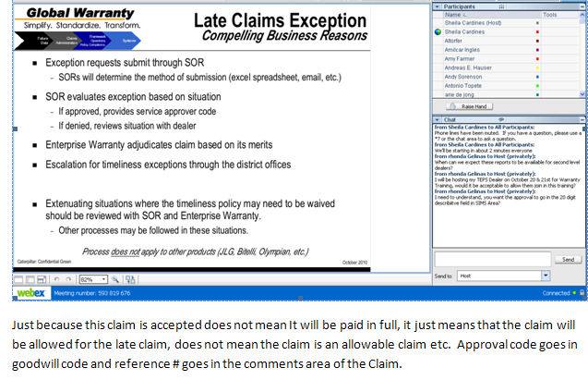
LATE Claims Exceptions

Slide 93
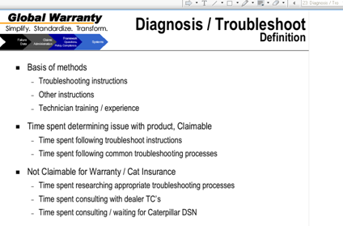
TRG

Slide 94
Send it BACK & Warranty Parts handling
  Warranty Cores – How do you handle
  Orange Tags
  TRR
  Green Tags

Slide 95
TRG Question/Concerns
ADD SERVICE IMAGE TO ASSIST FOR ACCESS DIFFICULTIES

Slide 96
Diagnosis / Troubleshoot
Claiming recommendations
  Claim for published TRG troubleshoot time on applicable TRG troubleshoot line
  Claim for excess(claimable) troubleshoot time on 035 A (Quantity) line
  Justify excess troubleshoot time in claim story
    Encourage better troubleshooting tracking in service shops
    Provide clear expectations in claiming practices
    Improve ability to understand troubleshooting complexity
      Claim adjudication
      Product / guideline development

Slide 97
ECM – DOWNLOAD
BRUCE BERRY
PRODUCT STATUS REPORT
WARRANTY DOWNLOAD
ECM REPLACEMENT FILE

Slide 98
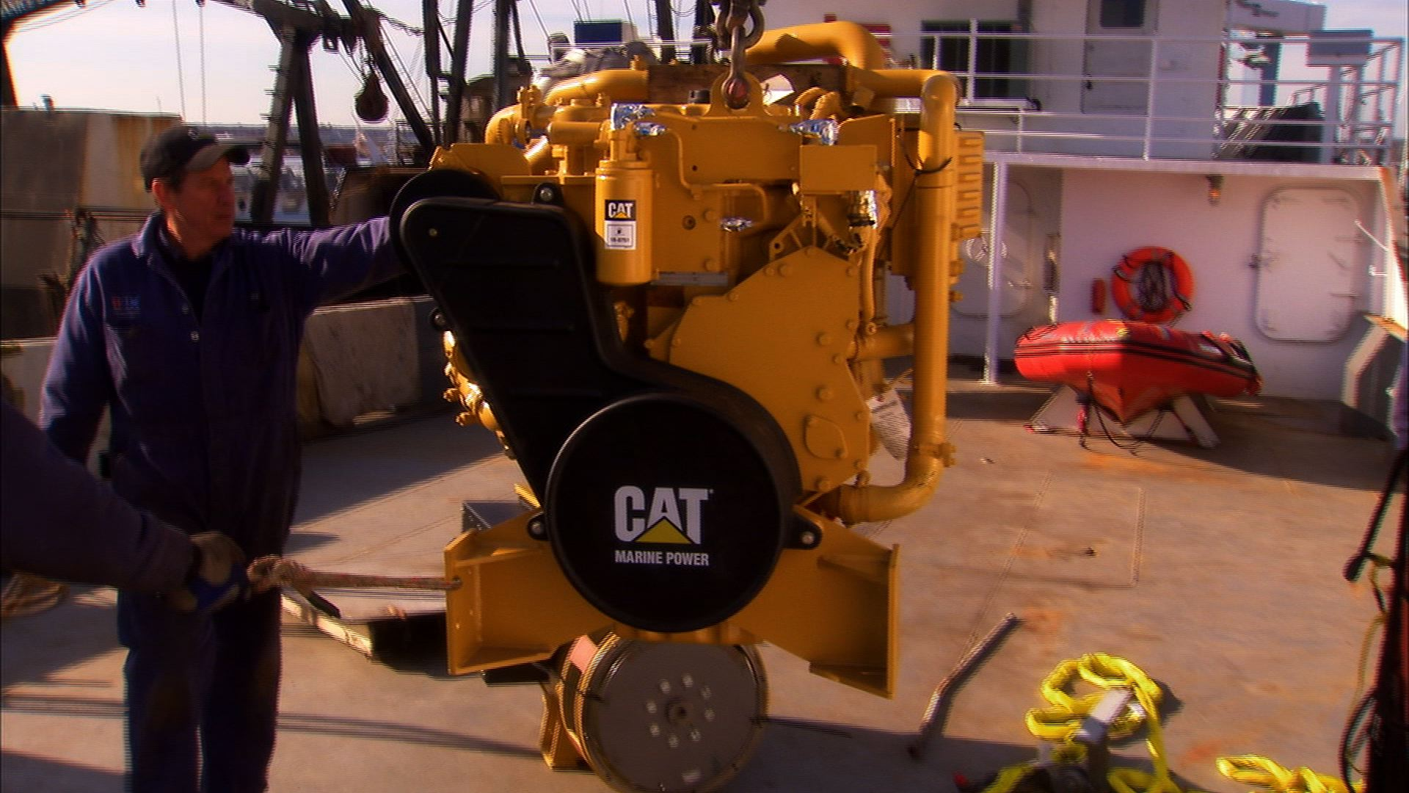
Product Services
ESC – Quote Tool

Slide 99
WHAT IS ESC?
A program that is purchased through Caterpillar Insurance for new, used or overhauled engines.
Program is component specific and is NOT an extension of Standard Warranty
When purchased the time is based off the original Date of Delivery running concurrently with the standard warranty period
  IE a 60 month program will expire 60 months from the original date of delivery however we would not file against the program until the standard coverage expires

Slide 100
2023 New Engine and Extended Service Coverage
New Engine
New Engine ESC
Overhaul ESC
Used Engine Advantage
Must purchase within the first 12 months of Standard Factory Warranty (SFW)
SFW:
  12 months Commercial
  24 months Pleasure
Up to 5 years of new engine coverage available – NOTE: runs concurrent with SFW
After 12 months a 25% late fee WILL be applied to the Coverage fee
Up to 5 years of Used Engine Advantage ESC available
Requires a passing engine certification with SOS results
Can purchase 12 month increments and upgrade out to 60 months with same certification
Up to 5 years of Overhaul Coverage an be purchased
Requires the completed Overhaul Certification
  Top End
  Major
  Recommended Only Platinum or Platinum Plus – WHY?

Slide 101
Milton Cat Checklist for ESC Quote Request

Slide 102
What is the difference between Silver, Gold and Platinum and Platinum Plus?
Silver Level Components are indicated by “Yes”
Gold Level Components are in addition to Silver Level and are indicated by “Yes 1” these are maintenance components – normal wear is not covered – All Covered Components must pass inspection or be replaced at the proper intervals as prescribed by the O&M Manual.
Milton Cat Quotes only Platinum and Platinum Plus whenever possible. Keep the experience positive.

Slide 103
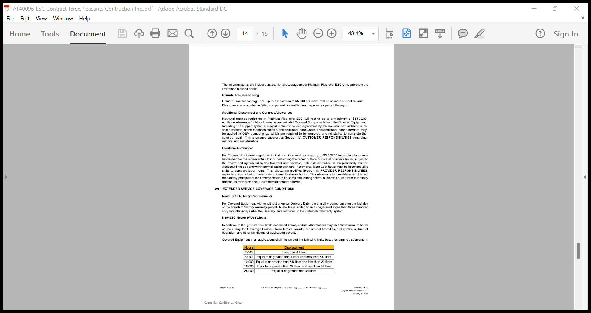
Platinum Plus continued

Slide 104
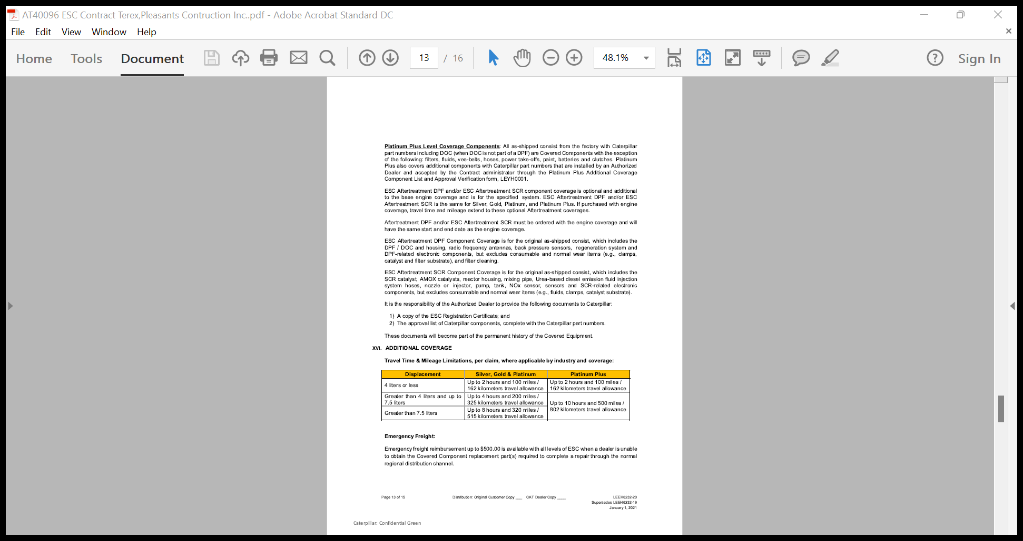
Additional Coverage for Platinum Plus

Slide 105
Marketing Update
2023 programs

Slide 106
2023 Marketing Programs for Industrial
Must show discount to customer up front where applicable
Must be submitted to Milton Cat within 30 days for claiming and reimbursement
All programs and material can be found on our ISD Website at:
ISDs: Industrial Service Dealers for Heavy Equipment and Power Systems | Milton CAT

Slide 107
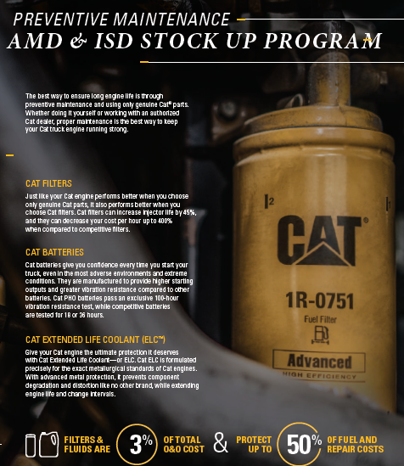



2023 Marketing Programs for Industrial
Packaged Solutions
Overhaul ESC
Overhaul and Repairs Special
Stock Up Program

Slide 108
Thank you!
Your Milton Cat Industrial Team!
Q&A

