Slide 1
Meeting Agenda
Day 1
Day 2
11:00 AM | Registration & Lunch, Meet & Greet, Buffet lunch
12:00 PM | Welcome & Introductions (Meeting Start)
12:15 PM | New Product Sales (2 hr.)
2:15 PM | Break (15 mins)
2:30 PM | Product Support (2.5 hr.)
5:00 PM | Daily Wrap-Up – Question/Answer Session
5:30 PM | Transportation to offsite event and dinner
7:00 AM | Breakfast
8:00 AM | Service (2.5 hr.)
10:30 AM | Break (15 mins)
10:45 AM | Open Forum
11:50 AM | Meeting Wrap Up
12:00 PM | Meeting Ends, Box lunches to go

Slide 2
New Product Sales
Nick Fawle
Dave Nunnally
Kevin Hampson

Slide 3
Engine Lineup
AMD Days, April 4-5 2023

Slide 4
Agenda
Engine Lineup – Nick
New Product Introduction – Nick
Hybrid – Nick / Kevin
AMD Product Selector, Live Demo – Dave / Nick
Inventory – Dave
Cat Finance – Jeff Condo
Product Availability – Jim
Cat Pricing – Jim
Wrap Up - All

Slide 5
2023 AMD Dealer Days
ESC and Marketing

Slide 6
Rhonda Gelinas – Milton Cat AMD Program
Program Overview and personnel-
Rhonda Gelinas Program Manager
John Dendas – AMD Coordinator & Product Support
Parts and Service Agreements
Labor rate support *
Program guidelines and Product Support
Lucas Patch – Technical Support Communicator (TC) & Dealer Service’s Support
Sea Trials
Failure Analysis
DSN
Wanda Muzzey – Administrative Assistant
Marci Benedict – Warranty Admin for Sales and Warranty Information

Slide 7
Product Support
John Dendas

Slide 8
Service
Lucas Patch
Rhonda Gelinas

Slide 9
Standard Warranty, Extended Service Coverage and Marketing Programs
Rhonda Gelinas
Product Support Manager
E&T Business Partners, ESC & Marketing

Slide 10
2023 New Engine and Extended Service Coverage
New Engine
New Engine ESC
Overhaul ESC
Used Engine Advantage
Must purchase within the first 12 months of Standard Factory Warranty (SFW)
SFW:
12 months Commercial
24 months Pleasure
Up to 5 years of new engine coverage available – NOTE: runs concurrent with SFW
After 12 months a 25% late fee WILL be applied to the Coverage fee
Up to 5 years of Used Engine Advantage ESC available
Requires a passing engine certification with SOS results
Can purchase 12 month increments and upgrade out to 60 months with same certification
Up to 5 years of Overhaul Coverage an be purchased
Requires the completed Overhaul Certification
Top End
Major
Recommended Only Platinum or Platinum Plus – WHY?

Slide 11
2023 Marketing Programs for Marine
Must show discount to customer up front where applicable
Must be submitted to Milton Cat within 30 days for claiming and reimbursement
All programs and material can be found on our AMD Website at: https://www.miltoncat.com/engines/cat-marine-diesel/authorized-marine-dealers

Slide 12
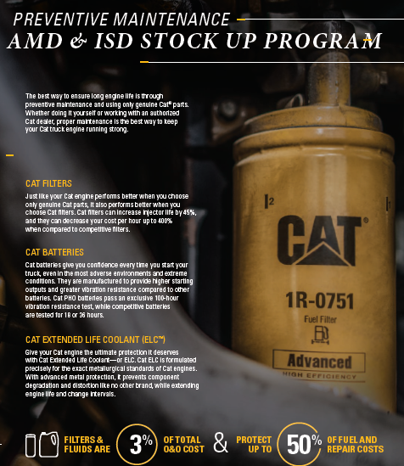
2023 Marketing Programs for Marine
Packaged Solutions
Overhaul ESC
Overhaul and Repairs Special
Stock Up Program

Slide 13
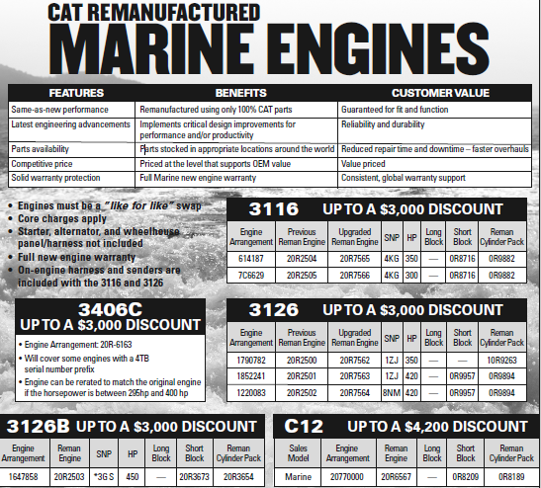
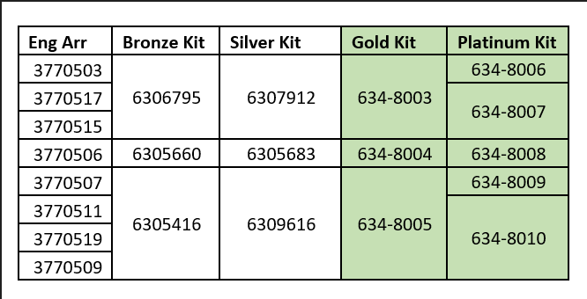
Programs Coming Soon
Reman Engine Program
Precious Metals Program
Parts ordered
Milton Cat will kitting in North Reading

Slide 14
Thank you!
Your Milton Cat Marine Team!

